Slide 1
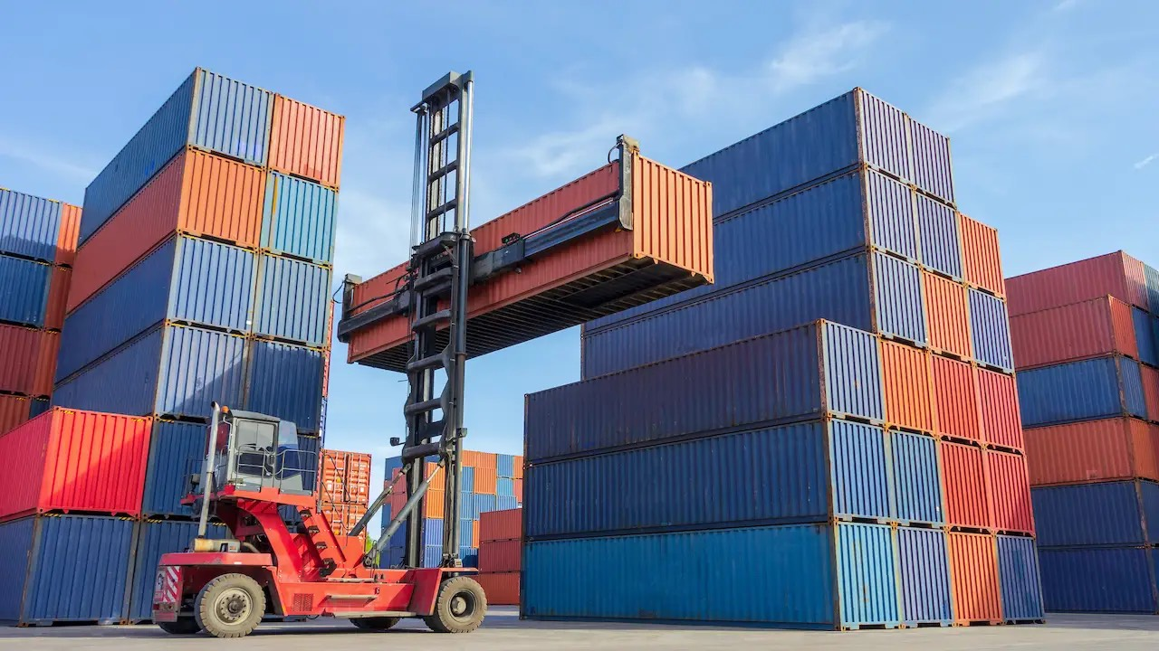
What are containers?

Slide 2
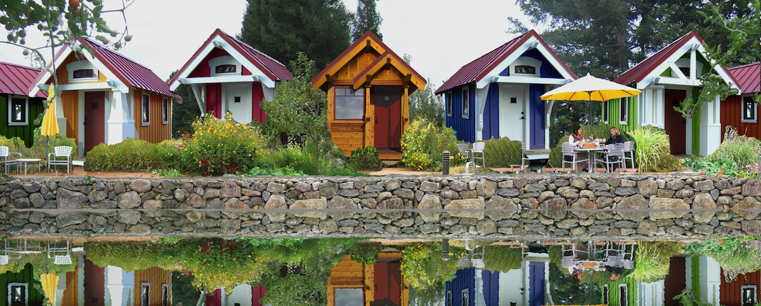
Let’s Start with VMs
Independent and isolated
Notes:
Helpful to reflect on history a bit. Apps install on OS, OS installs on hardware.
Need to add a second house (build) and separate plumbing, electricity
Single unit, self-contained
Own utilities, water heater, etc.
Own front door, etc.
Want another house, build another house

Slide 3
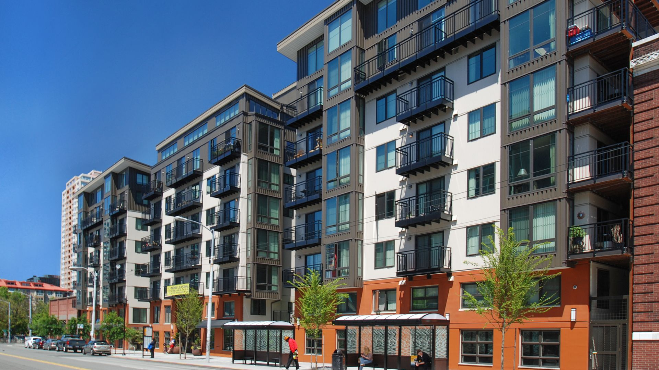
Containers are like Apartments
Smaller, Shared Infrastructure
Notes:
Helpful to reflect on history a bit. Apps install on OS, OS installs on hardware.
Need to add a second house (build) and separate plumbing, electricity
Single unit, self-contained
Own utilities, water heater, etc.
Own front door, etc.
Want another house, build another house

Slide 4
Containers have no OS
Containers are an app level construct
VMs are an infrastructure level construct to turn one machine into many servers

Slide 5
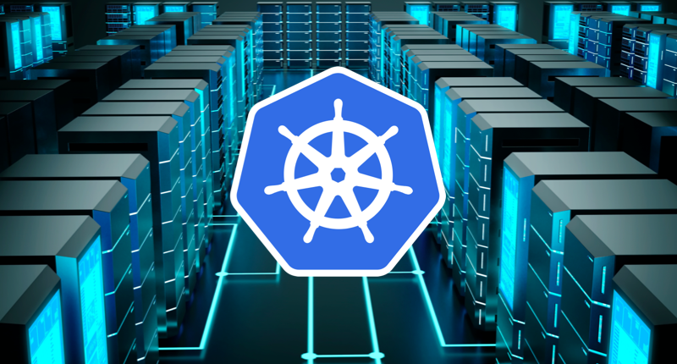
What is Kubernetes?

Slide 6
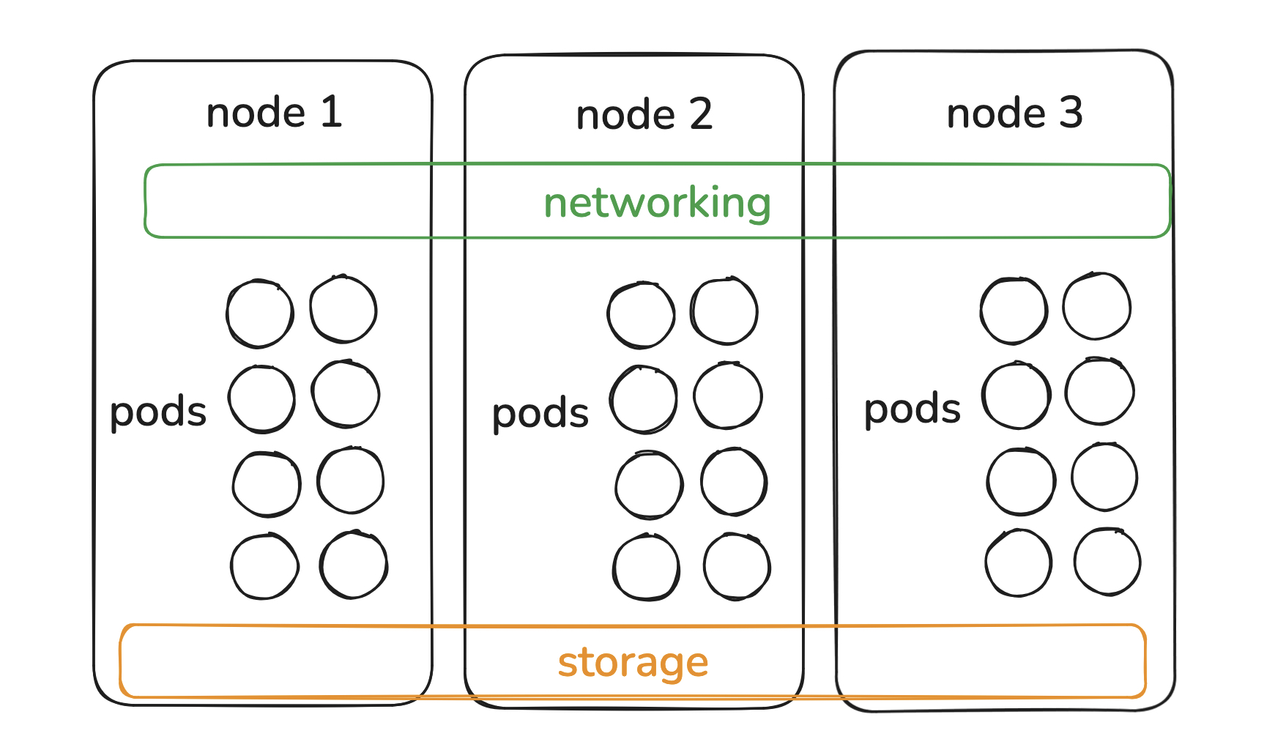
Kubernetes Orchestrates
pods are combined containers

Slide 7
No Really, Why K8s?
Service discovery and load balancing
Storage orchestration
Automation
Self-healing
Secret Management
from : https://kubernetes.io/docs/concepts/overview/what-is-kubernetes/

