Slide 1
Pillar 7 Visibility and Analytics
CW3 Ben Koontz
Notes:
Hello, my name is CW3 Ben Koontz and I will be covering the topic, Zero Trust, Pillar 1 Users.

Slide 2
Course Objectives
The student will be able to understand the Visibility and Analytics Pillar of Zero Trust
The student will understand the 6 capabilities and 18 activities outlined in the Visibility and Analytics Pillar
Notes:
The course objectives are as follows:
The student will be able to understand the Visibility and Analytics Pillar of Zero Trust
The student will understand the 6 capabilities and 18 activities outlined in the Visibility and Analytics Pillar

Slide 3
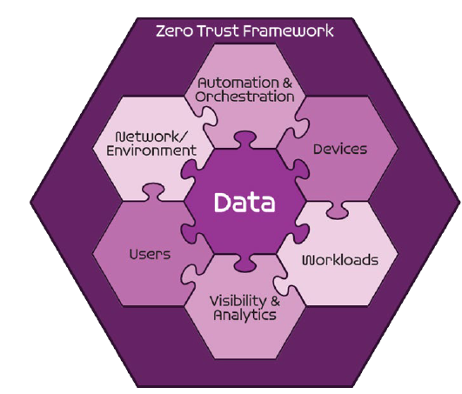
Seven Pillars of Zero Trust
User
Device
Applications and Workload
Data
Network and Environment
Automation and Orchestration
Visibility and Analytics
DoD ZT Reference Architecture v 2.0
Notes:
The Zero Trust seven pillars are protection pillars that work together to effectively secure the data pillar. These pillars are in alignment with industry but may have different names.
The seventh and final pillar is visibility and analytics which provides an understanding of the performance of a ZT architecture as well as the detection of anomalous behavior or activity.

Slide 4
Sample Zero Trust Access Flow
Vulnerability Mgmt
Resource Authorization
DevSecops
1
EDR./XDR
Comply to connect
Device inventory
Devices
Applications & Workload
authenticate
Services
request
Policy Enforcement Point
4
3
[user, device]
authenticate
Micro Segmentation
Macro Segmentation
SOAR
Machine Learning
Artificial intelligence
Policy Orchestration
data
Orchestration & Automation
DLP
DRM
DATA ACLs
Data Tags and Labels
2
Users
Network & Environment
MFA
PAM
ICAM
User ACLs
User Attributes
Logs
Logs
Logs
Logs
Logs
5
SIEM
Behavior analytics
Threat analytics
Threat intelligence
Visibility & Analytics
Device Authenticates
User Authenticates
Access Decision at PEP
Access to Data and Services
Security Analytics Decision
Notes:
The visibility and analytics pillar is constantly monitoring all actions within a Zero Trust Environment and through the use of Orchestration and Automation it provides data points to the policy enforcement point to deny or allow access. Some key components of the Visibility and analytics pillar are the SIEM, threat and behavior analytics and threat intelligence.

Slide 5
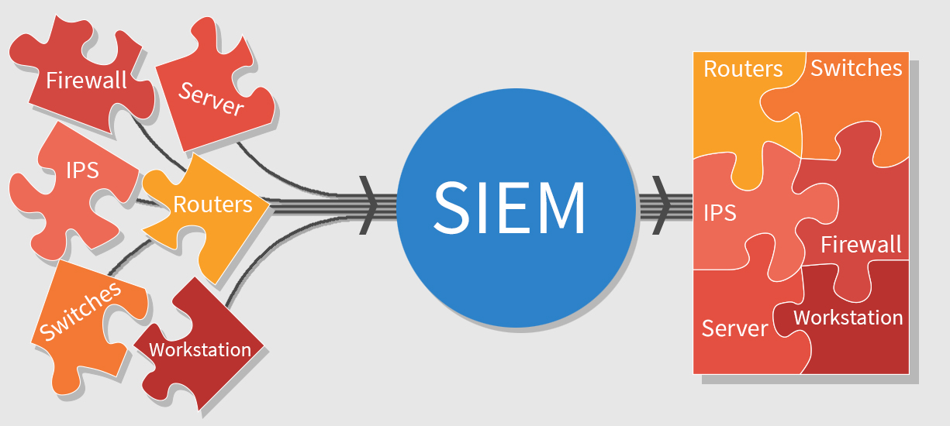
Visibility and Analytics Pillar
7.1 Log All Traffic (Network, Data, Apps, Users)
7.1.1 Scale Considerations (Target)
7.1.2 Log Parsing (Target)
7.1.3 Log Analysis (Target)
Notes:
The first capability is to log all traffic (network, data, apps, and users) and has three associated activites.
Scale considerations has the following requirements: Sufficient infrastructure in place; Distributed environment established; Sufficient bandwidth for network traffic.
Log Parsing has the following requirements: Standardized log formats; Rules developed for each log format.
Log Analysis has the following requirements: Develop analytics per activity; Identify activities to analyze.

Slide 6
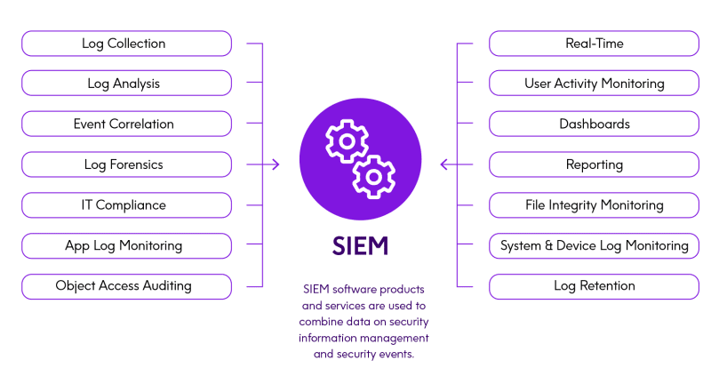
Visibility and Analytics Pillar
7.2 Security Information and Event Management (SIEM)
7.2.1 Threat Alerting Pt1 (Target)
7.2.2 Threat Alerting Pt2 (Target)
7.2.3 Threat Alerting Pt3 (Advanced)
7.2.4 Asset ID & Alert Correlation (Target)
7.2.5 User/Device Baselines (Target)
Notes:
The second capability is security information and event management (SIEM) and has five associated activities.
Threat Alerting Pt1 has the following requirements: Rules developed for threat correlation.
Threat Alerting Pt2 has the following requirements: Develop analytics to detect deviations.
Threat Alerting Pt3 has the following requirements: Identify Triggering Anomalous Events; Implement Triggering Policy.
Asset ID & Alert Correlation has the following requirements: Rules developed for asset ID based responses.
User/Device baselines has the following requirements: Identify user and device baselines.

Slide 7
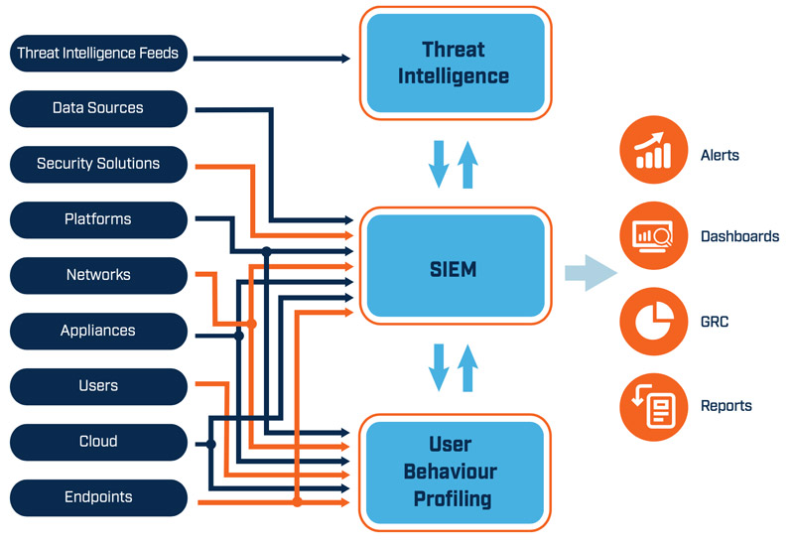
Visibility and Analytics Pillar
7.3 Common Security and Risk Analytics
7.3.1 Implement Analytics Tools (Target)
7.3.2 Establish User Baseline Behavior (Target)
Notes:
The third capability is common security and risk analytics and has two associated activities.
Implement Analytics Tools has the following requirements: Develop requirements for analytic environment; Procure and implement analytic tools.
Establish User Baseline Behavior has the following requirements: Identify users for baseline; Establish ML-based baselines.

Slide 8
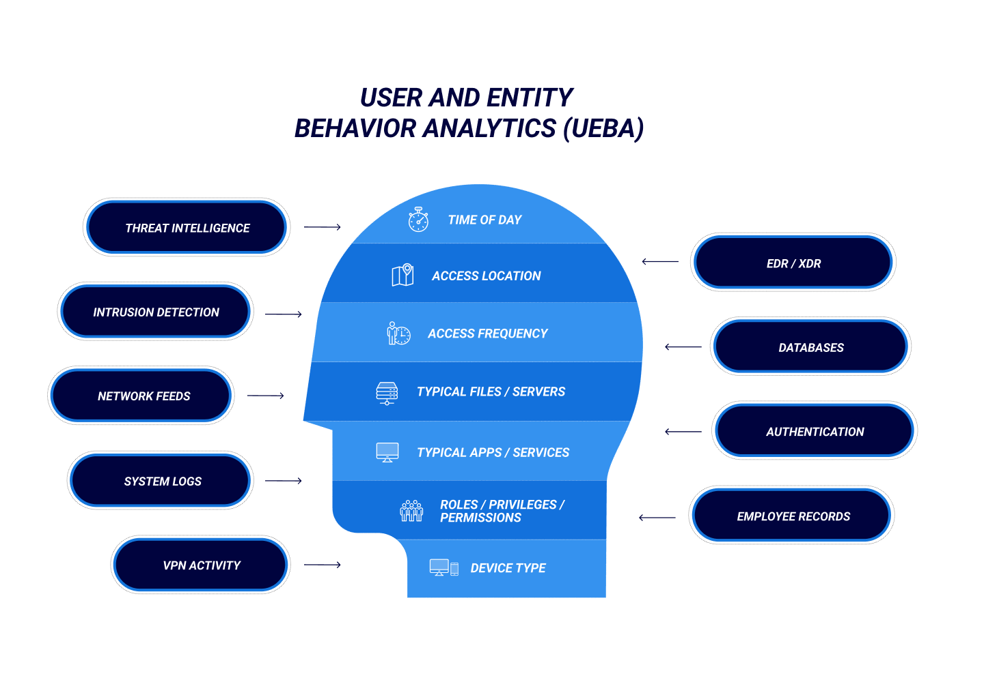
Visibility and Analytics Pillar
7.4 User and Entity Behavior Analytics
7.4.1 Baseline & Profiling Pt1 (Target)
7.4.2 Baseline & Profiling Pt2 (Advanced)
7.4.3 UEBA Baseline Support Pt1 (Advanced)
7.4.4 UEBA Baseline Support Pt2 (Advanced)
Notes:
The fourth capability is user and entity behavior analytics and it has four associated activites.
Baseline and profiling Pt1 has the following requirements: Develop analytics to detect changing threat conditions; Identify user and device threat profiles.
Baseline and profiling Pt2 has the following requirements: Add threat profiles for IoT and OT devices; Develop and extend analytics; Extend threat profiles to individual users and devices.
UEBA Baseline Support Pt1 has the following requirements: Implement ML-based Analytics to detect anomalies
UEBA Baseline Support Pt2 has the following requirements: Implement ML-based Analytics to detect anomalies

Slide 9
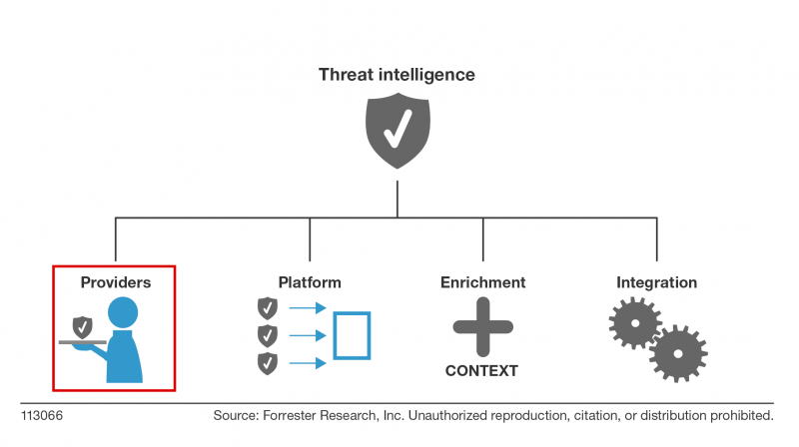
Visibility and Analytics Pillar
7.5 Threat Intelligence Integration
7.5.1 Cyber Threat Intelligence Program Pt1 (Target)
7.5.2 Cyber Threat Intelligence Program Pt2 (Target)
Notes:
The fifth capability is threat intelligence integration and it has two associated activities.
Cyber Threat Intelligence Program Pt1 has the following requirements: Cyber Threat Intelligence team is in place with critical stakeholders; Public and Baseline CTI feeds are being utilized by SIEM for alerting; Basic integration points exist with Device and Network enforcement points (e.g., NGAV, NGFW, NG-IPS).
Cyber Threat Intelligence Program Pt2 has the following requirements: Cyber Threat Intelligence team is in place with extended stakeholders as appropriate; Controlled and Private feed are being utilized by SIEM and other appropriate Analytics tools for alerting and monitoring; Integration is in place for extended enforcement points within the Device, User, Network and Data pillars (UEBA, UAM) .

Slide 10
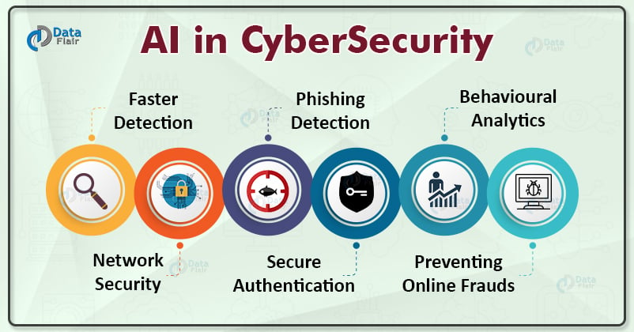
Visibility and Analytics Pillar
7.6 Automated Dynamic Policies
7.6.1 AI-enabled Network Access (Advanced)
7.6.2 AI-enabled Dynamic Access Control (Advanced)
Notes:
The sixth and final capability is automated dynamic policies which has two associated activities.
AI-enabled Network access has the following requirements: Network Access is AI driven based on environment analytics.
AI-enabled Dynamic Access Control has the following requirements: JIT/JEA are integrated with AI; Access is AI driven based on environment analytics.

Slide 11
Conclusion
Visibility and Analytics Pillar
Key Components:
Security Information and Event Management (SIEM)
Threat Analytics
Threat Intelligence
Behavior Analytics
Logging and Log Analysis
Notes:
The visibility and analytics pillar is used as a checks and balances for the entire zero trust architecture to ensure the Zero Trust policies are operating as intended. In addition to providing the visibility of the environment, this pillar is very threat focused and is used to prevent, detect, and respond to adversary activity.
The most important component is the SIEM. Threat analytics, threat intelligence, logging and behavior analytics are all fed into the SIEM and then correlated to provide actionable events to the security operations team or cyber security service providers.

Slide 12
Questions
CW3 Ben Koontz; benjamin.r.koontz2.mil@army.mil
Notes:
Please feel free to e-mail me or contact me on Office 365 Teams for any questions on the presentation or Zero Trust in general.

