Slide 1
Pillar 6 Automation and Orchestration
CW3 Ben Koontz
Notes:
Hello, my name is CW3 Ben Koontz and I will be covering the topic, Zero Trust, Pillar 6 Automation and Orchestration.

Slide 2
Course Objectives
The student will be able to understand the Automation and Orchestration Pillar of Zero Trust
The student will understand the 7 capabilities and 20 activities outlined in the Automation and Orchestration Pillar
Notes:
The course objectives are as follows:
The student will be able to understand the Automation and Orchestration Pillar of Zero Trust
The student will understand the 7 capabilities and 20 activities outlined in the Automation and Orchestration Pillar

Slide 3
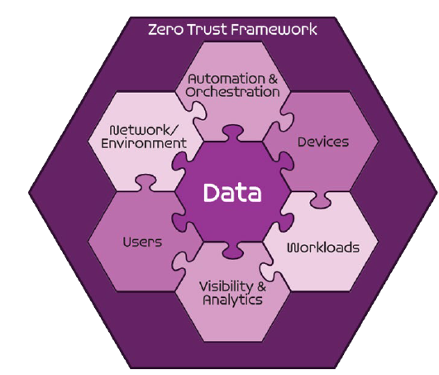
Seven Pillars of Zero Trust
User
Device
Applications and Workload
Data
Network and Environment
Automation and Orchestration
Visibility and Analytics
DoD ZT Reference Architecture v 2.0
Notes:
The Zero Trust seven pillars are protection pillars that work together to effectively secure the data pillar. These pillars are in alignment with industry but may have different names.
The sixth pillar is automation and orchestration and it covers automating manual processes in order to take policy-based actions with speed and scale across an enterprise.

Slide 4
Sample Zero Trust Access Flow
Vulnerability Mgmt
Resource Authorization
DevSecops
1
EDR./XDR
Comply to connect
Device inventory
Devices
Applications & Workload
authenticate
Services
request
Policy Enforcement Point
4
3
[user, device]
authenticate
Micro Segmentation
Macro Segmentation
SOAR
Machine Learning
Artificial intelligence
Policy Orchestration
data
Automation & Orchestration
DLP
DRM
DATA ACLs
Data Tags and Labels
2
Users
Network & Environment
MFA
PAM
ICAM
User ACLs
User Attributes
Logs
Logs
Logs
Logs
Logs
5
SIEM
Behavior analytics
Threat analytics
Threat intelligence
Visibility & Analytics
Device Authenticates
User Authenticates
Access Decision at PEP
Access to Data and Services
Security Analytics Decision
Notes:
The automation and orchestration pillar is responsible for integrating the other pillars of zero trust into a full working architecture. It is also used to make the architecture more efficient by automating manual tasks and by integrating machine learning and AI into the architecture.

Slide 5
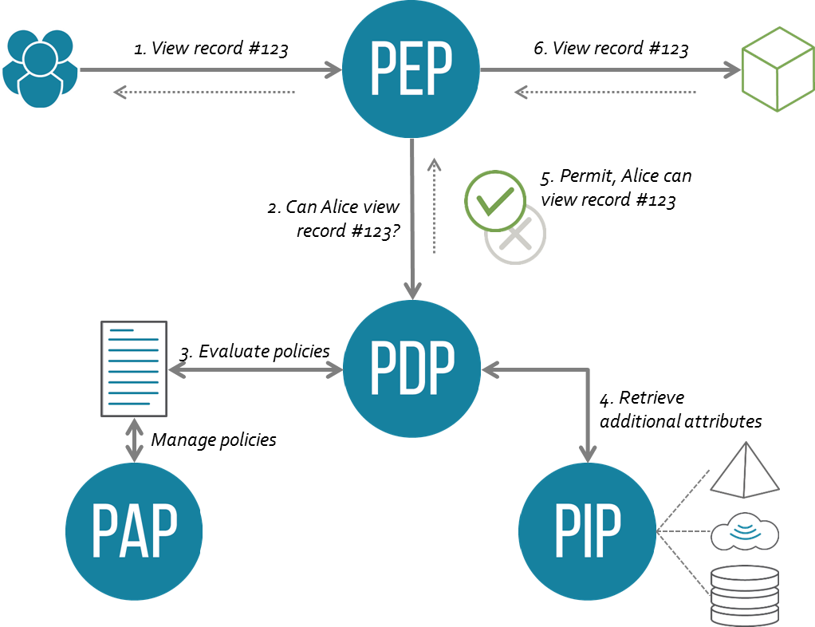
Automation and Orchestration Pillar
6.1 Policy Decision Point (PDP) & Policy Orchestration
6.1.1 Policy Inventory & Development (Target)
6.1.2 Organization Access Profile (Target)
6.1.3 Enterprise Security Profile Pt1 (Target)
6.1.4 Enterprise Security Profile Pt2 (Advanced)
Notes:
The first capability is Policy Decision Point (PDP) and Policy Orchestration which has four associated activities.
Policy Inventory and Development has the following requirements: Policies have been collected in reference to applicable compliance and risk (eg RMF, NIST); Policies have been reviewed for missing Pillars and Capabilities per the ZTRA; Missing areas of policies are updated to meet the capabilities per ZTRA.
Organization Access Profile has the following requirements: Organization scoped profile(s) are created to determine access to DAAS using capabilities from User, Data, Network, and Device pillars; Initial enterprise profile access standard is developed for access to DAAS ; When possible the organization profile(s) utilizes enterprise available services in the User, Data, Network and Device pillars; Organization Mission/Task critical profile(s) are created.
Enterprise Security Profile Pt1 has the following requirements: Enterprise Profile(s) are created to access DAAS using capabilities from User, Data, Network and Device Pillars; Non-mission/task critical organization profile(s) are integrated with the enterprise profile(s) using a standardized approach.
Enterprise Security Profile Pt2 has the following requirements: Enterprise Profile(s) have been reduced and simplified to support widest array of access to DAAS; Where appropriate Mission/Task Critical profile(s) have been integrated and supported Organization profiles are considered the exception.

Slide 6
Automation and Orchestration Pillar
6.2 Critical Process Automation
6.2.1 Task Automation Analysis (Target)
6.2.2 Enterprise Integration & Workflow Provisioning Pt1 (Target)
6.2.3 Enterprise Integration & Workflow Provisioning Pt2 (Advanced)
Notes:
The second capability is critical process automation which has three associated activites.
Task Automation Analysis has the following requirements: Automatable tasks are identified; Tasks are enumerated.
Enterprise Integration and Workflow provisioning Pt1 has the following requirements: Implement full enterprise integration; Identify key integrations; Identify recovery and protection requirements.
Enterprise Integration and Workflow provisioning Pt2 has the following requirements: Services identified; Service provisioning is implemented.

Slide 7
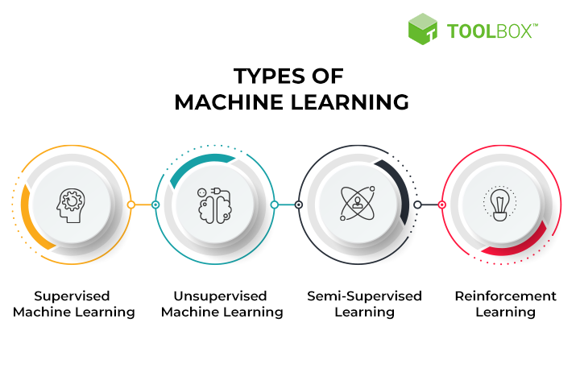
Automation and Orchestration Pillar
6.3 Machine Learning
6.3.1 Implement Data Tagging & Classification ML Tools (Target)
Notes:
The third capability is machine learning and it has one associated activity.
Implement Data Tagging & Classification ML Tools has the following requirements: Implemented data tagging and classification tools are integrated with ML tools.

Slide 8
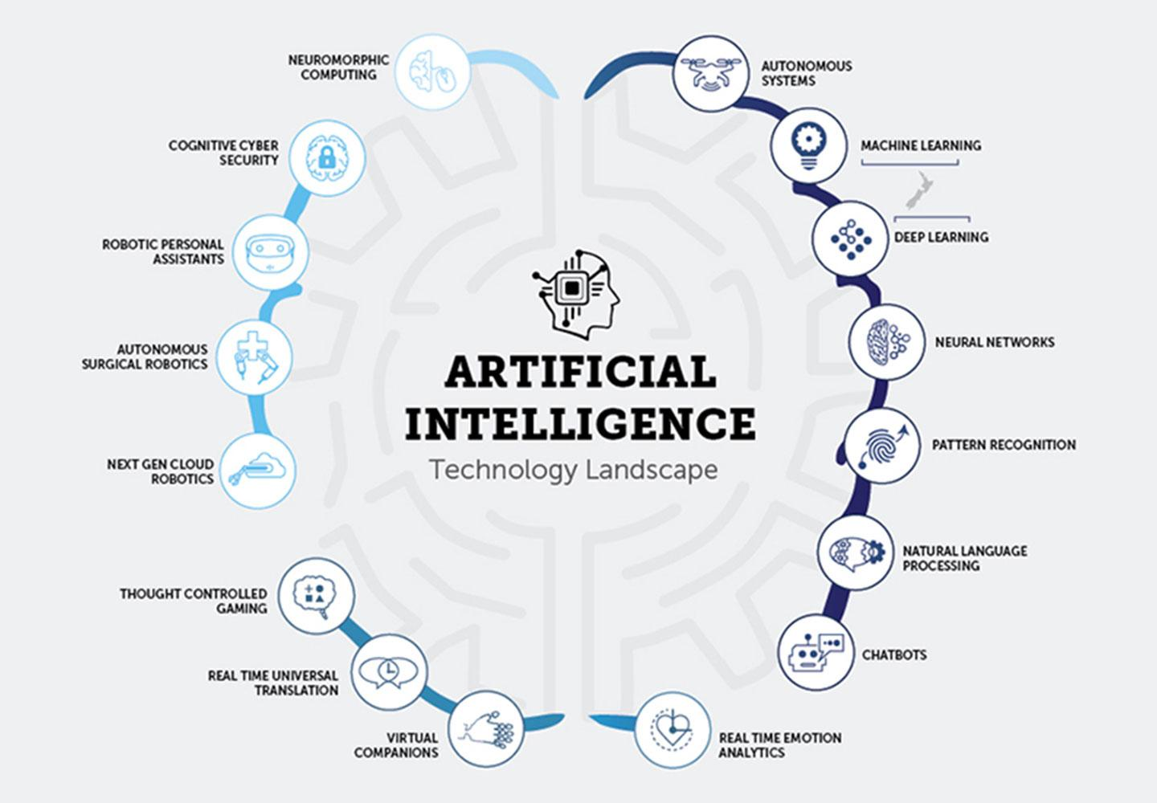
Automation and Orchestration Pillar
6.4 Artificial Intelligence
6.4.1 Implement AI automation tools (Advanced)
6.4.2 AI Driven by Analytics decides A&O modifications (Advanced)
Notes:
The fourth capability is artificial intelligence and it has two associated activities.
Implement AI automation tools has the following requirements: Develop AI Tool Requirements; Procure and Implement AI Tools.
AI Driven by analytics decides A&O modifications has the following requirements: AI is able to make changes to automated workflow activities

Slide 9
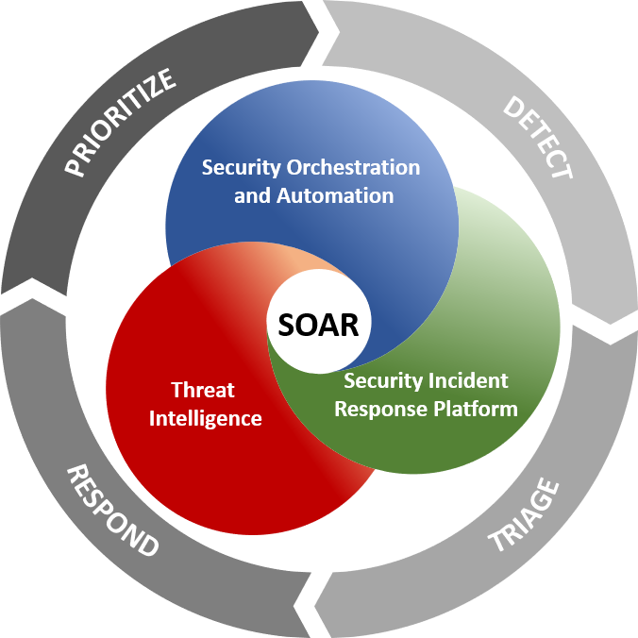
Automation and Orchestration Pillar
6.5 Security Orchestration, Automation & Response (SOAR)
6.5.1 Response Automation Analysis (Target)
6.5.2 Implement SOAR Tools (Target)
6.5.3 Implement Playbooks (Advanced)
Notes:
The fifth capability is security orchestration automation and response (SOAR) and has three associated activities.
Response Automation Analysis has the following requirements: Automatable response activities are identified; Response activities are enumerated.
Implement SOAR tools has the following requirements: Develop requirements for SOAR tool; Procure SOAR tools.
Implement Playbooks has the following requirements: When possible automated playbooks based on automated workflows capability; Manual Playbooks are developed and implemented.

Slide 10
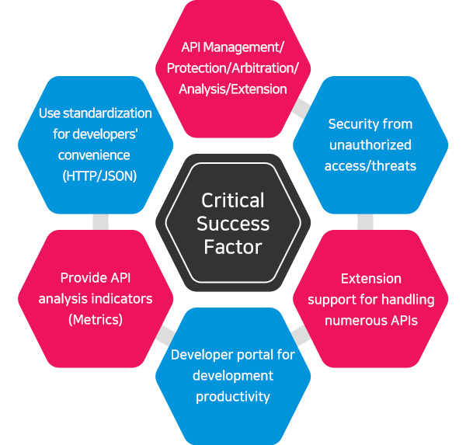
Automation and Orchestration Pillar
6.6 API Standardization
6.6.1 Tool Compliance Analysis (Target)
6.6.2 Standardized API Calls & Schemas Pt1 (Target)
6.6.3 Standardized API Calls & Schemas Pt2 (Target)
Notes:
The sixth capability is API standardization and it has three associated activities.
Tool Compliance Analysis has the following requirements: API status is determined compliance or non-compliance to API standards; Tools to be used are Identified.
Standardized API Calls & Schemas Pt1 has the following requirements: Initial calls and schemas are implemented; Non-compliant tools are replaced.
Standardized API Calls & Schemas Pt2 has the following requirements: All calls and schemas are implemented.

Slide 11
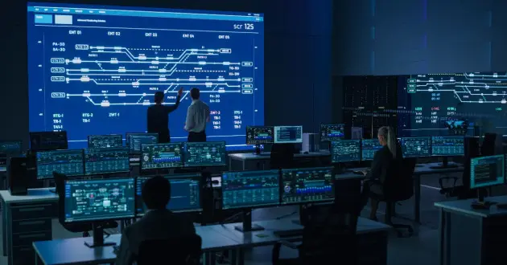
Automation and Orchestration Pillar
6.7 Security Operations Center (SOC) & Incident Response (IR)
6.7.1 Workflow Enrichment Pt1 (Target)
6.7.2 Workflow Enrichment Pt2 (Target)
6.7.3 Workflow Enrichment Pt3 (Advanced)
6.7.4 Automated Workflow (Advanced)
Notes:
The seventh and final capability is security operations center (SOC) & incident response (IR) with four associated activites.
Workflow Enrichment Pt1 has the following requirements: Threat events are identified; Workflows for threat events are developed.
Workflow Enrichment Pt2 has the following requirements: Workflows for Advanced threat events are developed; Advanced Threat events are identified.
Workflow Enrichment Pt3 has the following requirements: Enrichment data has been identified; Enrichment data is integrated into workflows.
Automated workflow has the following requirements: Workflow processes are fully automated; Manual Processes have been identified; Remaining Processes are marked as exceptions and documented.

Slide 12
Conclusion
Automation and Orchestration Pillar
Key Components:
Security Orchestration, Automation, and Response
APIs
Machine Learning
Artificial Intelligence
Workflows
Security Operations Center and Incident Response
Policy Decision Points
Policy Orchestration
Notes:
The automation and orchestration pillar is very important in making zero trust policies more efficient, effective and to utilize the latest technology to significantly improve security and operations.
A SOAR capability is extremely powerful once you are able to get it running and you have developed all of your workflows and manual tasks. Some example use cases of a SOAR is to identify your most common security alerts, or your most common workflows in your environment and to automate them so you remove as many manual tasks as you can to allow your analysts to work on more difficult and more advanced techniques. Machine Learning and Artificial Intelligence are both very important to implement in order to sort through data and analytics that are impossible to be done manually. ML and AI can completely change how we do security if done effectively. In addition to this, the automation and orchestration pillar gets after incident response and security operations as well as policy decision points. Policy decision points are locations within an environment that collect data points about data, assets, applications and users and makes an access decision that is sent to a policy enforcement point for enforcement.

Slide 13
Questions
CW3 Ben Koontz; benjamin.r.koontz2.mil@army.mil
Notes:
Please feel free to e-mail me or contact me on Office 365 Teams for any questions on the presentation or Zero Trust in general.

