Slide 1
Pillar 4 Data
CW3 Ben Koontz
Notes:
Hello, my name is CW3 Ben Koontz and I will be covering the topic, Zero Trust, Pillar 4 Data.

Slide 2
Course Objectives
The student will be able to understand the Data Pillar of Zero Trust
The student will understand the 7 capabilities and 31 activities outlined in the Data Pillar
Notes:
The course objectives are as follows:
The student will be able to understand the Data Pillar of Zero Trust
The student will understand the 7 capabilities and 31 activities outlined in the Data Pillar

Slide 3
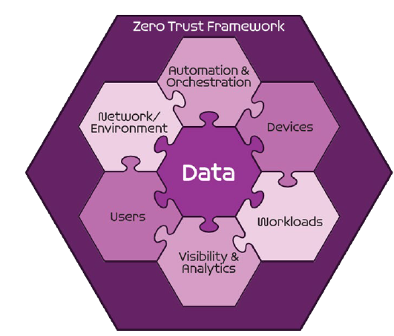
Seven Pillars of Zero Trust
User
Device
Applications and Workload
Data
Network and Environment
Automation and Orchestration
Visibility and Analytics
DoD ZT Reference Architecture v 2.0
Notes:
The Zero Trust seven pillars are protection pillars that work together to effectively secure the data pillar. These pillars are in alignment with industry but may have different names.
The fourth pillar is data and it includes the organization’s method of protecting and categorizing data.

Slide 4
Sample Zero Trust Access Flow
Vulnerability Mgmt
Resource Authorization
DevSecops
1
EDR./XDR
Comply to connect
Device inventory
Devices
Applications & Workload
authenticate
Services
request
Policy Enforcement Point
4
3
[user, device]
authenticate
Micro Segmentation
Macro Segmentation
SOAR
Machine Learning
Artificial intelligence
Policy Orchestration
data
Orchestration & Automation
DLP
DRM
DATA ACLs
Data Tags and Labels
2
Users
Network & Environment
MFA
PAM
ICAM
User ACLs
User Attributes
Logs
Logs
Logs
Logs
Logs
5
SIEM
Behavior analytics
Threat analytics
Threat intelligence
Visibility & Analytics
Device Authenticates
User Authenticates
Access Decision at PEP
Access to Data and Services
Security Analytics Decision
Notes:
The data pillar is responsible for the protection, tagging, and categorization of data.
In this slide, data is the final assessment in the Zero Trust access flow and is the most important pillar of Zero Trust, because the other pillars are used together to protect the data.
The Data pillar uses Data Loss Prevention techniques that look for sensitive data being exfilled from the environment. Digital Rights Management (DRM) solutions are implemented to prevent the theft on sensitive information, so that even if the adversary were to successfully exfil data, then they would not be able to open the file due to DRM. In addition to DRM and DLP, access control lists with granular data tagging and labels are important to effectively protect data and ensure only those that need access to the data can access it.

Slide 5
Data Pillar
4.1 Data Catalog Risk Alignment
4.1.1 Data Analysis (Target)
Notes:
The first capability is Data Catalog Risk Alignment and has one associated activity.
Data Analysis has the following requirements: The service catalog is updated with data types for each application and service based on data classification levels.

Slide 6
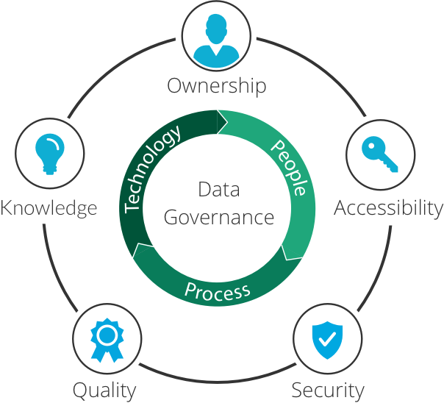
Data Pillar
4.2 DoD Enterprise Data Governance
4.2.1 Define Data Tagging Standards (Target)
4.2.2 Interoperability Standards (Target)
4.2.3 Develop Software Defined Storage (SDS) Policy (Target)
Notes:
The second capability is DoD Enterprise Data Governance and has three associated activities.
Define Data Tagging Standards has the following requirements: Enterprise data classification and tagging standards are developed; Organizations align to enterprise standards and begin implementation.
Interoperability Standards has the following requirements: Formal standards are in place by the Enterprise for the appropriate data standards.
Develop Software Defined Storage (SDS) Policy has the following requirements: Determine need for SDS tool implementation; Policy for SDS is created at the enterprise and org levels.

Slide 7
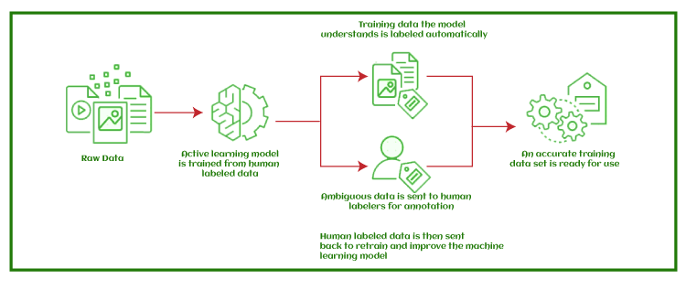
Data Pillar
4.3 Data Labeling and Tagging
4.3.1 Implement Data Tagging & Classification Tools (Target)
4.3.2 Manual Data Tagging Pt1 (Target)
4.3.3 Manual Data Tagging Pt2 (Advanced)
4.3.4 Automated Data Tagging & Support Pt1 (Advanced)
4.3.5 Automated Data Tagging & Support Pt2 (Advanced)
Notes:
The third capability is Data Labeling and Tagging and has five associated activities.
Implement Data Tagging & Classification Tools has the following requirements: A requirement of Data classification and tagging tools must include integration and/or support of Machine Learning (ML); Data classification and tagging tools are implemented at org and enterprise levels.
Manual Data Tagging Pt1 has the following requirements: Manual data tagging begins at the enterprise level with basic attributes.
Manual Data Tagging Pt2 has the following requirements: Manual data tagging is expanded to the program/org levels with specific attributes.
Automated Data Tagging & Support Pt1 has the following requirements: Basic automation begins by scanning data repositories and applying tags.
Automated Data Tagging & Support Pt2 has the following requirements: Full automation of data tagging is completed; Results of data tagging are fed into ML algorithms to develop AI driven data tagging.

Slide 8
Data Pillar
4.4 Data Monitoring and Sensing
4.4.1 DLP Enforcement Point Logging and Analysis (Target)
4.4.2 DRM Enforcement Point Logging and Analysis (Target)
4.4.3 File Activity Monitoring Pt1 (Target)
4.4.4 File Activity Monitoring Pt2 (Target)
4.4.5 Database Activity Monitoring (Advanced)
4.4.6 Comprehensive Data Activity Monitoring (Advanced)
Notes:
The fourth capability is Data Monitoring and Sensing and has six associated activities.
DLP Enforcement Point Logging and Analysis has the following requirements: Enforcement points are identified; Standardized Logging schema is enforced at the enterprise and org levels.
DRM Enforcement Point Logging and Analysis has the following requirements: Enforcement points are identified; Standardized Logging schema is enforced at the enterprise and org levels.
File Activity Monitoring Pt1 has the following requirements: Data and files of critical classification are actively being monitored; Basic Integration is in place with monitoring system such as the SIEM.
File Activity Monitoring Pt2 has the following requirements: Data and files of all regulated classifications are actively being monitored; Extended integrations are in place as appropriate to further manage risk.
Database Activity Monitoring has the following requirements: Appropriate Database are being actively monitored; Monitoring technology is integrated with solutions such as SIEM, PDP and Dynamic Access Control mechanisms.
Comprehensive Data Activity Monitoring has the following requirements: Data Activity monitoring mechanisms are integrated to provide a unified view of monitoring across data repositories; Appropriate integrations exist with solutions such as SIEM and PDP.

Slide 9
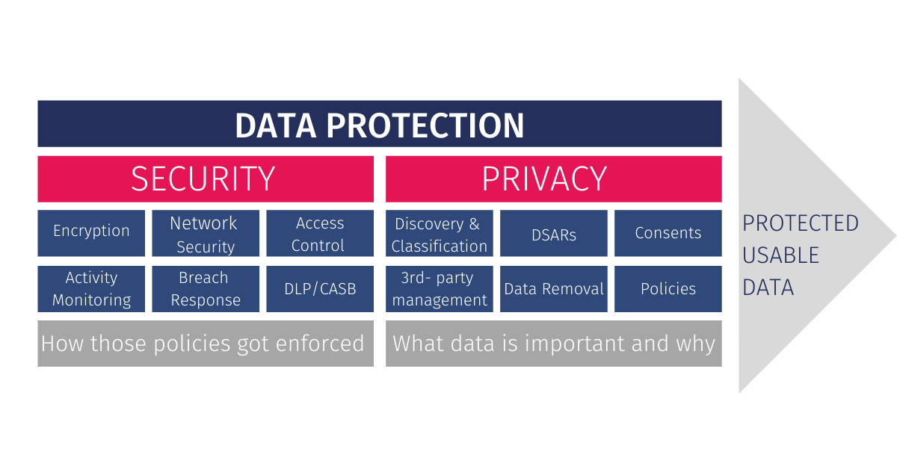
Data Pillar
4.5 Data Encryption & Rights Management
4.5.1 Implement DRM and Protection Tools Pt1 (Target)
4.5.2 Implement DRM and Protection Tools Pt2 (Target)
4.5.3 DRM Enforcement via Data Tags and Analytics Pt1 (Target)
4.5.4 DRM Enforcement via Data Tags and Analytics Pt2 (Advanced)
4.5.5 DRM Enforcement via Data Tags and Analytics Pt3 (Advanced)
Notes:
The fifth capability is Data Encryption & Rights Management and has five associated activities.
Implement DRM and Protection Tools Pt1 has the following requirements: DRM and protection tools are enabled for high risk data repositories with basic protections.
Implement DRM and Protection Tools Pt2 has the following requirements: DRM and protection tools are enabled for possible repositories.
DRM Enforcement via Data Tags and Analytics Pt1 has the following requirements: Data Tags are integrated with DRM and monitored repositories are expanded; Based on data tags, data is encrypted at rest.
DRM Enforcement via Data Tags and Analytics Pt2 has the following requirements: All applicable data repositories are protected using DRM; Data is encrypted using extended data tags from the org levels.
DRM Enforcement via Data Tags and Analytics Pt3 has the following requirements: Analytics from ML/AI are integrated with DRM to better automate protections; Encryption protection is integrated with AI/ML and updated encryption methods are used as needed.

Slide 10
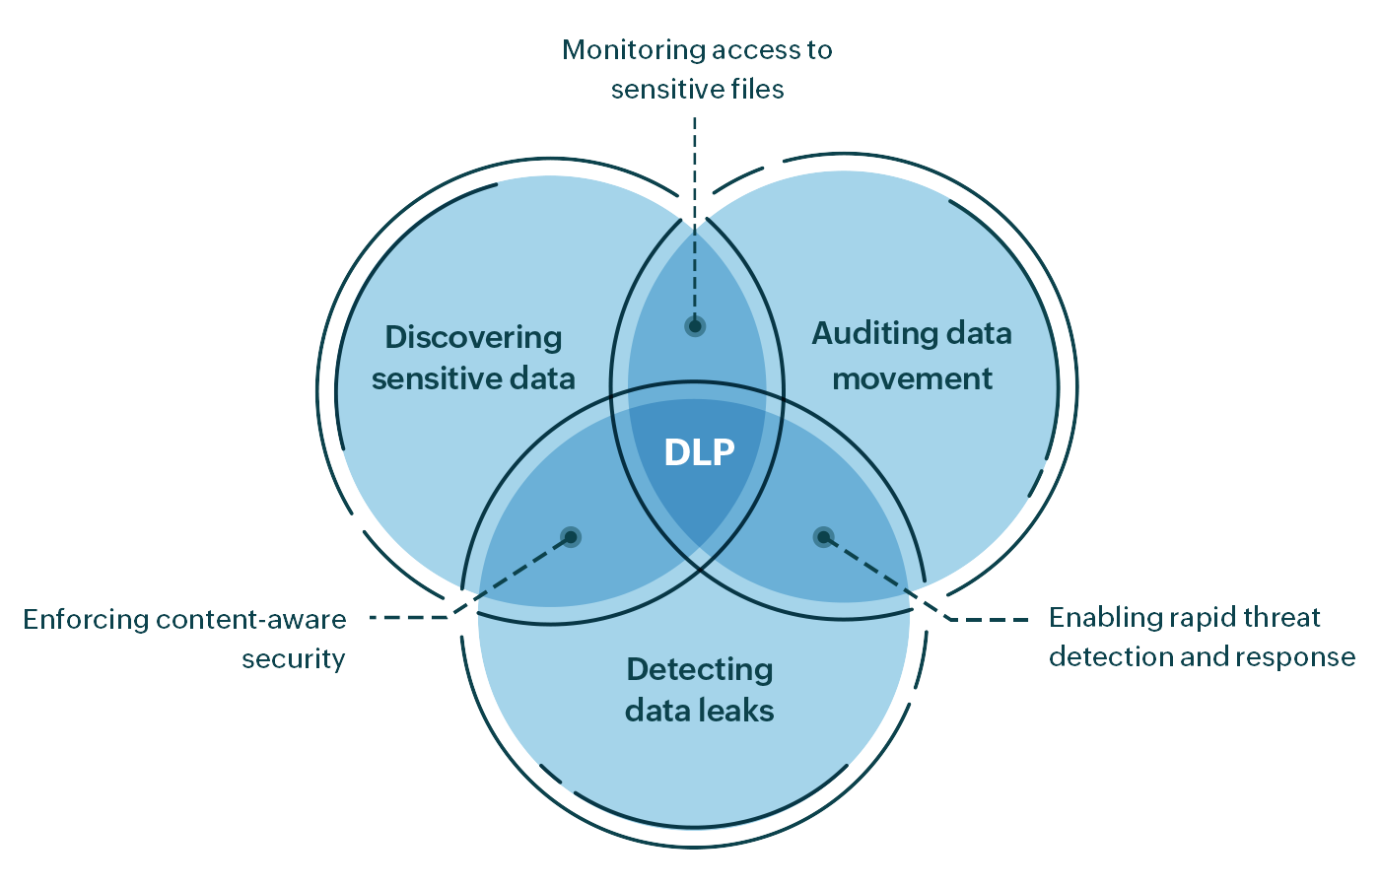
Data Pillar
4.6 Data Loss Prevention (DLP)
4.6.1 Implement Enforcement Points (Target)
4.6.2 DLP Enforcement via Data Tags and Analytics Pt1 (Target)
4.6.3 DLP Enforcement via Data Tags and Analytics Pt2 (Advanced)
4.6.4 DLP Enforcement via Data Tags and Analytics Pt3 (Advanced)
Notes:
The sixth capability is Data Loss Prevention and has four associated activities.
Implement Enforcement Points has the following requirements: Identified enforcement points have DLP tool deployed and set to monitor mode with standardized logging.
DLP Enforcement via Data Tags and Analytics Pt1 has the following requirements: Enforcement Points to set to prevent mode integrating the logging schema and manual tags.
DLP Enforcement via Data Tags and Analytics Pt2 has the following requirements: Enforcement points have extended data tag attributes applied for additional prevention.
DLP Enforcement via Data Tags and Analytics Pt3 has the following requirements: Automated tagging attributes are integrated with DLP and resulting metrics are used for ML.

Slide 11
Data Pillar
4.7 Data Access Control
4.7.1 Integrate DAAS Access w/ SDS Policy Pt1 (Target)
4.7.2 Integrate DAAS Access w/ SDS Policy Pt2 (Advanced)
4.7.3 Integrate DAAS Access w/ SDS Policy Pt3 (Advanced)
4.7.4 Integrate Solution(s) and Policy with Enterprise IDP Pt1 (Target)
4.7.5 Integrate Solution(s) and Policy with Enterprise IDP Pt2 (Advanced)
4.7.6 Implement SDS Tool and/or integrate with DRM Tool Pt1 (Advanced)
4.7.7 Implement SDS Tool and/or integrate with DRM Tool Pt2 (Advanced)
Notes:
The seventh and final capability within the data pillar is Data Access Control and it has seven associated activities.
Integrate DAAS Access w/ SDS Policy Pt1 has the following requirements: DAAS policy is developed w/ enterprise and org level support; SDS Integration plan is developed to support DAAS policy.
Integrate DAAS Access w/ SDS Policy Pt2 has the following requirements: DAAS Policy implemented in an automated fashion.
Integrate DAAS Access w/ SDS Policy Pt3 has the following requirements: SDS is integrated with DAAS policy functionality.
Integrate Solution(s) and Policy with Enterprise IDP Pt1 has the following requirements: Integration plan with SDS is developed to support existing DAAS access.
Integrate Solution(s) and Policy with Enterprise IDP Pt2 has the following requirements: If needed implement SDS tooling and integrate with Enterprise IDP to support existing DAAS access .
Implement SDS Tool and/or integrate with DRM Tool Pt1 has the following requirements: If tooling is needed ensure there is supported integrations with DLP, DRM and ML tooling.
Implement SDS Tool and/or integrate with DRM Tool Pt2 has the following requirements: Integrate SDS infrastructure with existing DLP and DRM infrastructure.

Slide 12
Conclusion
Data Pillar
Key Components:
Data Loss Prevention
Digital Rights Management
Data Access Control Lists
Data Tagging and Labeling
Data Monitoring
Notes:
The data pillar of Zero Trust is extremely important in the overall implementation of ZT and all other pillars are built to protect the data pillar.
For the data pillar, there are different capabilities directly tied to protecting the data while others are used to enable other capabilities, such as machine learning and AI. Data Loss Prevention and Digital Rights management are used to directly protect data from being stolen. Access Control Lists are there to limit access to data to only those that require access and Data Tagging and Labeling is used to assist more granular access controls and to assist with machine learning and AI functions. Finally Data monitoring is critical as a checks and balances for data access.

Slide 13
Questions
CW3 Ben Koontz; benjamin.r.koontz2.mil@army.mil
Notes:
Please feel free to e-mail me or contact me on Office 365 Teams for any questions on the presentation or Zero Trust in general.

