Slide 1
Pillar 3 Applications and Workload
CW3 Ben Koontz
Notes:
Hello, my name is CW3 Ben Koontz and I will be covering the topic, Zero Trust, Pillar 3 Applications and Workload.

Slide 2
Course Objectives
The student will be able to understand the Applications and Workload Pillar of Zero Trust
The student will understand the 5 capabilities and 18 activities outlined in the Applications and Workload Pillar
Notes:
The course objectives are as follows:
The student will be able to understand the Applications and Workload Pillar of Zero Trust
The student will understand the 5 capabilities and 18 activities outlined in the Applications and Workload Pillar

Slide 3
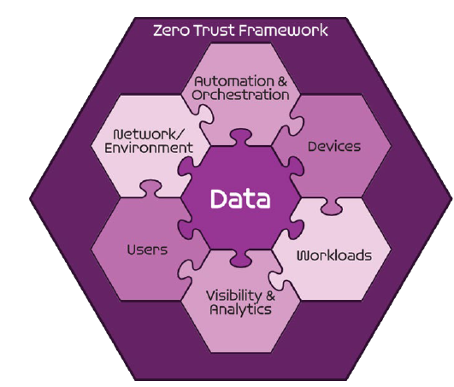
Seven Pillars of Zero Trust
User
Device
Applications and Workload
Data
Network and Environment
Automation and Orchestration
Visibility and Analytics
DoD ZT Reference Architecture v 2.0
Notes:
The Zero Trust seven pillars are protection pillars that work together to effectively secure the data pillar. These pillars are in alignment with industry but may have different names.
The third pillar is the applications and workload pillar and it includes applications or services running either on-premises or in a cloud environment.

Slide 4
Sample Zero Trust Access Flow
Vulnerability Mgmt
Resource Authorization
DevSecops
1
EDR./XDR
Comply to connect
Device inventory
Devices
Applications & Workload
authenticate
Services
request
Policy Enforcement Point
4
3
[user, device]
authenticate
Micro Segmentation
Macro Segmentation
SOAR
Machine Learning
Artificial intelligence
Policy Orchestration
data
Orchestration & Automation
DLP
DRM
DATA ACLs
Data Tags and Labels
2
Users
Network & Environment
MFA
PAM
ICAM
User ACLs
User Attributes
Logs
Logs
Logs
Logs
Logs
5
SIEM
Behavior analytics
Threat analytics
Threat intelligence
Visibility & Analytics
Device Authenticates
User Authenticates
Access Decision at PEP
Access to Data and Services
Security Analytics Decision
Notes:
The applications and workload pillar is responsible for vulnerability management, resource authorization and DevSecOps.
In this slide, the applications and workload pillar assesses the vulnerabilities within the environment to ensure Operating Systems and Applications are compliant and are free from vulnerabilities when a device attempts to access resources or data in an environment. The applications and workload pillar also gets after what applications are allowed in the environment and who can access what resources. It also looks at the authority to operate process and provides key analytics information to the visibility and analytics pillar.

Slide 5
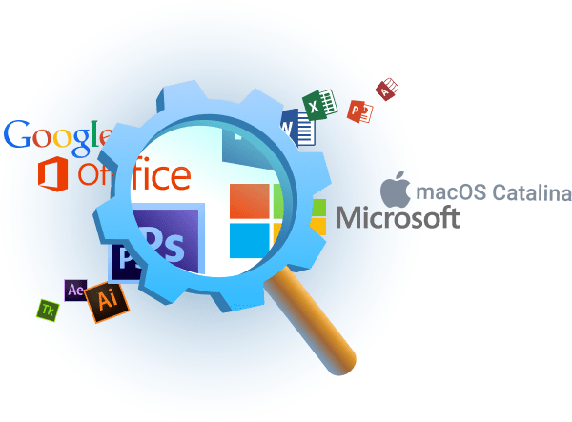
Applications and Workload Pillar
3.1 Application Inventory
3.1.1 Application/Code Identification (Target)
3.1.2 Resource Authorization Pt1 (Target)
3.1.3 Resource Authorization Pt2 (Target)
Notes:
The first capability outlined in the Applications and Workload Pillar is Application Inventory with three associated activities that fall beneath it.
Application/Code Identification has the following requirements: Component has identified applications and classified as either legacy, virtualized on-premises, and cloud hosted
Resource Authorization Pt1 has the following requirements: Resource Authorization Gateway is in place for external facing applications; Resource Authorization policy integrated with identity and device; Enterprise-wide Guidance on conversion standards are communicated to stakeholders.
Resource Authorization Pt1 has the following requirements: Resource Authorization gateway is utilized for all applications; Resource Authorization is integrated with DevSecOps and CI/CD for automated functions.

Slide 6
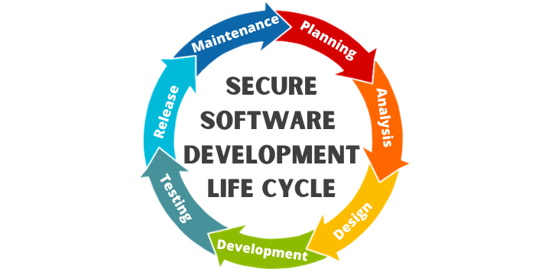
Applications and Workload Pillar
3.2 Secure Software Development & Integration
3.2.1 Build DevSecOps Software Factory Pt1 (Target)
3.2.2 Build DevSecOps Software Factory Pt2 (Target)
3.2.3 Automate Application Security & Code Remediation Pt1 (Advanced)
3.2.4 Automate Application Security & Code Remediation Pt2 (Advanced)
Notes:
The second capability within the applications and workload pillar is secure software development & integration which has four associated activities.
Build DevSecOps Software Factory Pt1 has the following requirements: Developed Data/Service Standards for DevSecOps; CI/CD Pipeline is fully functional and tested successfully; Vulnerability Management program is officially in place and operating.
Build DevSecOps Software Factory Pt2 has the following requirements: Development of applications is migrated to CI/CD pipeline; Continual validation process/technology is implemented and in use; Development of applications is migrated to DevSecOps process and technology.
Automate Application Security & Code Remediation Pt1 has the following requirements: Secure API Gateway is operational and majority of API calls are passing through gateway; Application Security functions (e.g., code review, container and serverless security) are implemented as part of CI/CD and DevSecOps.
Automate Application Security & Code Remediation Pt2 has the following requirements: Services are provided following a Service Oriented Architecture (SOA); Security Remediation activities (e.g., runtime security, library updates, release approvals) are fully automated.

Slide 7
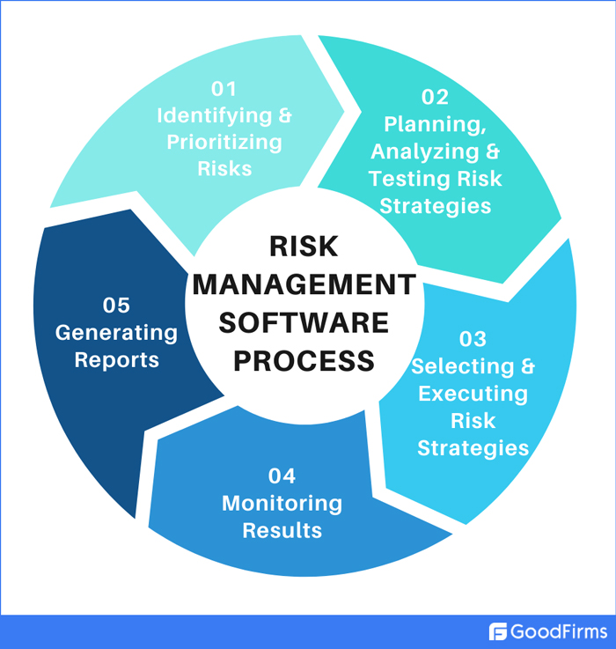
Applications and Workload Pillar
3.3 Software Risk Management
3.3.1 Approved Binaries/Code (Target)
3.3.2 Vulnerability Management Program Pt1 (Target)
3.3.3 Vulnerability Management Program Pt2 (Target)
3.3.4 Continual Validation (Target)
Notes:
The third capability is Software Risk Management and has four associated activities.
Approved Binaries/Code has the following requirements: Supplier sourcing risk evaluated and identified for approved sources; Repository and update channel established for use by development teams; Bill of Materials is created for applications identify source, supportability and risk posture; Industry standard (DIB) and approved vulnerability databases are pulled in to be used in DevSecOps.
Vulnerability Management Program Pt1 has the following requirements: Vulnerability Management Team is in place w/ appropriate stakeholder membership; Vulnerability Management policy and process is in place and agreed to w/ stakeholders; Public source of vulnerabilities are being utilized for tracking.
Vulnerability Management Program Pt2 has the following requirements: Controlled (e.g., DIB, CERT) sources of vulnerabilities are being utilized for tracking; Vulnerability management program has a process for accepting external/public disclosures for managed services.
Continual Validation has the following requirements: Updated Applications are deployed in a live and/or production environment; Applications that were marked for retirement and transition are decommissioned; Continual validation tools are implemented and applied to code in the CI/CD pipeline; Code requiring continuous validation is identified and validation criteria are established.

Slide 8
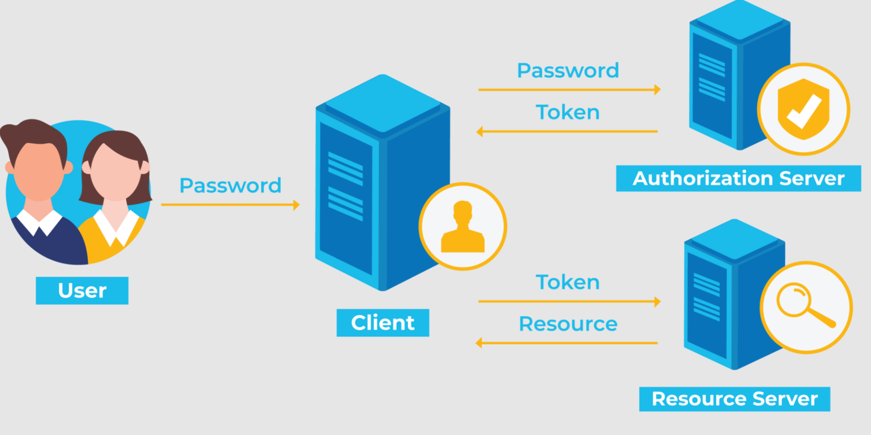
Applications and Workload Pillar
3.4 Resource Authorization & Integration
3.4.1 SDC Resource Authorization Pt1 (Target)
3.4.2 SDC Resource Authorization Pt2 (Target)
3.4.3 Enrich Attributes for Resource Authorization Pt1 (Advanced)
3.4.4 Enrich Attributes for Resource Authorization Pt2 (Advanced)
3.4.5 REST API Micro-Segments (Advanced)
Notes:
The fourth capability is resource authorization & integration which has five associated activities.
SDC Resource Authorization Pt1 has the following requirements: Applications unable to be updated to use approved binaries/code are marked for retirement and transition plans are created; Identified applications without approved binaries and code are updated to use approved binaries/code; Enterprise-wide Guidance on conversion standards are communicated to stakeholders.
SDC Resource Authorization Pt2 has the following requirements: Updated Applications are deployed in a live and/or production environment; Applications that were marked for retirement and transition are decommissioned.
Enrich Attributes for Resource Authorization Pt1 has the following requirements: Most API calls are passing through the Secure API Gateway; Resource Authorization receives data from Analytics Engine; Authorization policies incorporate identified attributes in making authorization decisions; Attributes to be used for initial enrichment are identified; Identified attributes are assigned to resources and/or entities.
Enrich Attributes for Resource Authorization Pt2 has the following requirements: Authorization policies incorporate confidence levels in making authorization decisions; Confidence levels for attributes are defined.
REST API Micro-Segments has the following requirements: Approved Enterprise APIs are Micro-Segmented appropriately.

Slide 9
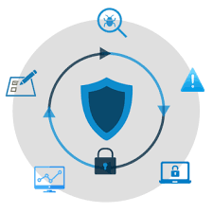
Applications and Workload Pillar
3.5 Continuous Monitoring and Ongoing Authorizations
3.5.1 Continuous Authorization to Operate (cATO) Pt1 (Advanced)
3.5.2 Continuous Authorization to Operate (cATO) Pt2 (Advanced)
Notes:
The fifth and final capability is Continuous Monitoring and Ongoing Authorizations which has two associated activities.
Continues Authorization to Operate (cATO) Pt1 has the following requirements: Controls derivation is standardized and ready for automation; Controls testing is integrated with DevSecOps processes and technology,
Continues Authorization to Operate (cATO) Pt2 has the following requirements: Controls testing is fully automated; Integration with standard IR and SOC operations is automated; Control derivation and applicability is fully automated; Dashboards are used to track continuing authorization status.

Slide 10
Conclusion
Applications and Workload Pillar
Key Components:
Application Inventory
Vulnerability Management
Resource Authorization
DevSecOps
Notes:
The applications and workload pillar of Zero Trust is extremely important in the overall implementation of ZT. We have covered which target and advanced activities that we are required to implement by 2027. Many of these are relevant to tactical environments where you will be directly implementing them, while others may be important for you to know about because they are being implemented at other levels and will require you to change how you operate in order to effectively be interoperable.
For the applications and workload pillar, implementing a technique to scan, assess and remediate vulnerabilities in your environment is critical. In addition to this, you need to identify all applications that are being utilized within your operating systems as well as which applications are being hosted and are providing services. For those applications providing services, you need to ensure resource authorization is utilizing the principal of least privilege to ensure resource access is provided to only those that require it with only the necessary permissions.

Slide 11
Questions
CW3 Ben Koontz; benjamin.r.koontz2.mil@army.mil
Notes:
Please feel free to e-mail me or contact me on Office 365 Teams for any questions on the presentation or Zero Trust in general.

