Slide 1
Pillar 2 Devices
CW3 Ben Koontz
Notes:
Hello, my name is CW3 Ben Koontz and I will be covering the topic, Zero Trust, Pillar 2 Devices.

Slide 2
Course Objectives
The student will be able to understand the Devices Pillar of Zero Trust
The student will understand the 7 capabilities and 24 activities outlined in the Devices Pillar
Notes:
The course objectives are as follows:
The student will be able to understand the Devices Pillar of Zero Trust
The student will understand the 7 capabilities and 24 activities outlined in the Devices Pillar

Slide 3
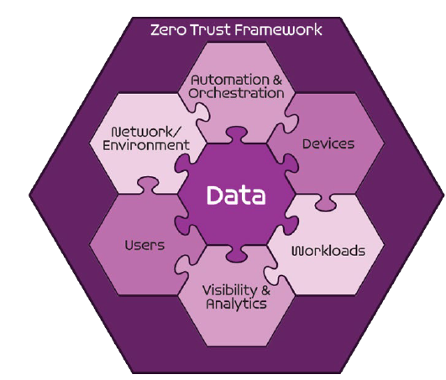
Seven Pillars of Zero Trust
User
Device
Applications and Workload
Data
Network and Environment
Automation and Orchestration
Visibility and Analytics
DoD ZT Reference Architecture v 2.0
Notes:
The Zero Trust seven pillars are protection pillars that work together to effectively secure the data pillar. These pillars are in alignment with industry but may have different names.
The second pillar is the device pillar which consists of continuous real-time authentication, inspection, assessment and patching of devices within an enterprise.

Slide 4
Sample Zero Trust Access Flow
Vulnerability Mgmt
Resource Authorization
DevSecops
1
EDR./XDR
Comply to connect
Device inventory
Devices
Applications & Workload
authenticate
Services
request
Policy Enforcement Point
4
3
[user, device]
authenticate
Micro Segmentation
Macro Segmentation
SOAR
Machine Learning
Artificial intelligence
Policy Orchestration
data
Orchestration & Automation
DLP
DRM
DATA ACLs
Data Tags and Labels
2
Users
Network & Environment
MFA
PAM
ICAM
User ACLs
User Attributes
Logs
Logs
Logs
Logs
Logs
5
SIEM
Behavior analytics
Threat analytics
Threat intelligence
Visibility & Analytics
Device Authenticates
User Authenticates
Access Decision at PEP
Access to Data and Services
Security Analytics Decision
Notes:
The devices pillar is responsible for asset management, device compliance, and device protection.
In this slide, the devices pillar is the first pillar that is assessed when a device attempts to access resources or data in an environment. If that device does not comply with the correct policies or patch levels, it will be unable to authenticate to the network.

Slide 5
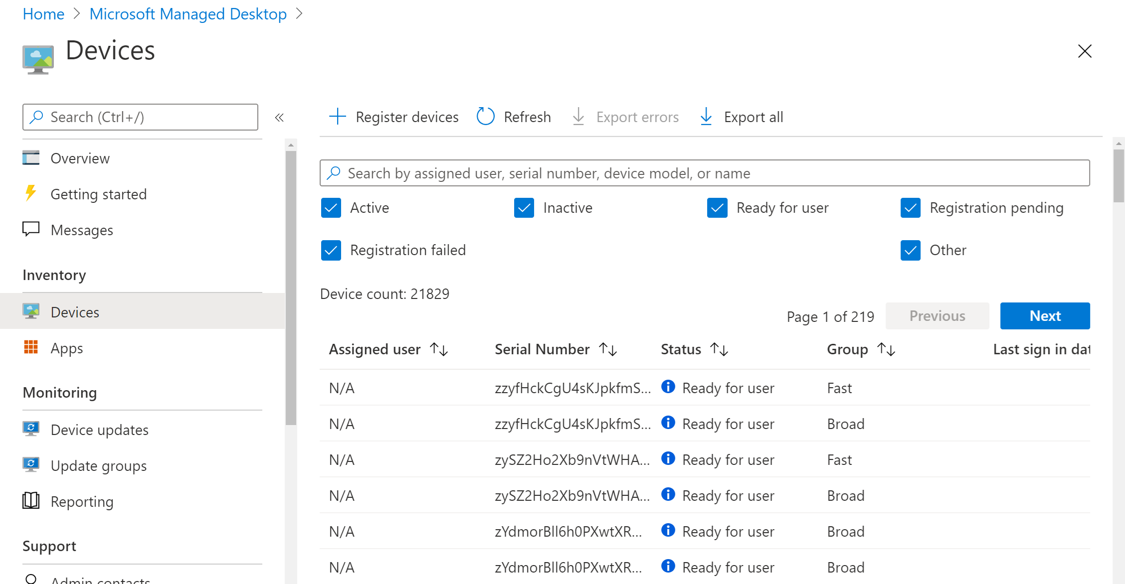
Device Pillar
2.1 Device Inventory
2.1.1 Device Health Tool Gap Analysis (Target)
2.1.2 NPE/PKI, Device under Management (Target)
2.1.3 Enterprise IDP Pt1 (Target)
2.1.4 Enterprise IDP Pt2 (Advanced)
Notes:
The first capability outlined in the Device Pillar is Device Inventory with four associated activities that fall beneath it.
Device Health Tool Gap Analysis has the following requirements: Manual inventory of devices is created per organization w/ owners.
This activity is dictating that each organization will have a method of inventorying their devices.
NPE/PKI, Device under Management has the following requirements: Non-person entities are managed via Org PKI and Org IDP.
This is saying that all traditional and non-traditional devices to include switches, routers, mobile devices, computers and anything else that is plugged into the environment will be managed with PKI and will have an identity in the identity provider (IDP).
Enterprise IDP Pt1 has the following requirements: NPEs including devices are integrated with Enterprise IDP.
Enterprise IDP Pt1 has the following requirements: Conditional device attributes are part of the IdP profile.
Conditional device attributes are used to assist with policy decisions. One example is a healthy or unhealthy device attribute, another may be the device type.

Slide 6
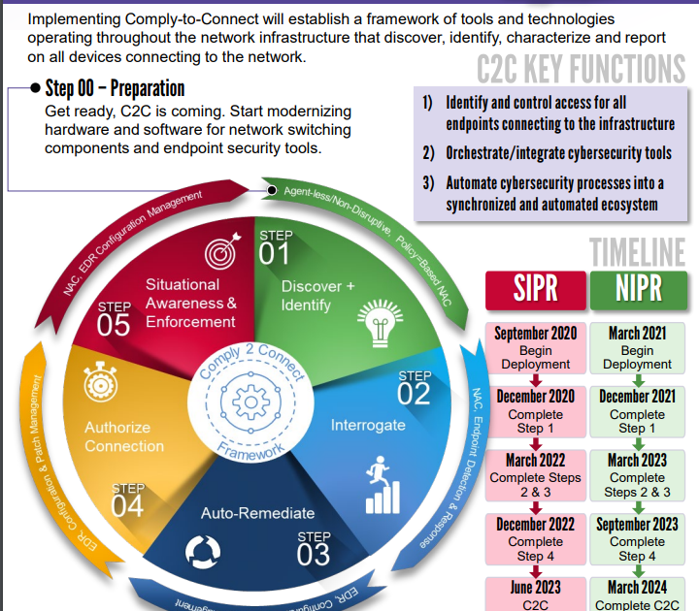
Device Pillar
2.2 Device Detection and Compliance
2.2.1 Implement C2C/Compliance Based Network Authorization Pt1 (Target)
2.2.2 Implement C2C/Compliance Based Network Authorization Pt2 (Advanced)
Notes:
The second capability of the Device Pillar is device detection and compliance and it has two associated activities.
Implement Comply To Connect (C2C) /Compliance Based Network Authorization Pt1 has the following requirements: C2C Rollout starts at the enterprise level for low risk and testing environments; Basic devices checks are implemented using C2C.
This means that each device authenticated to the network must pass basic comply to connect policies. Some examples are (MAC Address, Endpoint Security, Patch Compliance Level).
Implement C2C/Compliance Based Network Authorization Pt2 has the following requirements: C2C is rolled out to all supported environments; Advanced devices checks are completed and integrated with dynamic access (Enterprise IDP / ZTNA).
This means that not only have you implemented basic policies, but you are using advanced dynamic checks to continually validate the trust level of the system and apply dynamic access and decrease or increase access based on dynamic traits of your device. Some examples may be time of day, geographic location, antivirus status (Did your system trigger a virus alert?) or many other criteria.

Slide 7
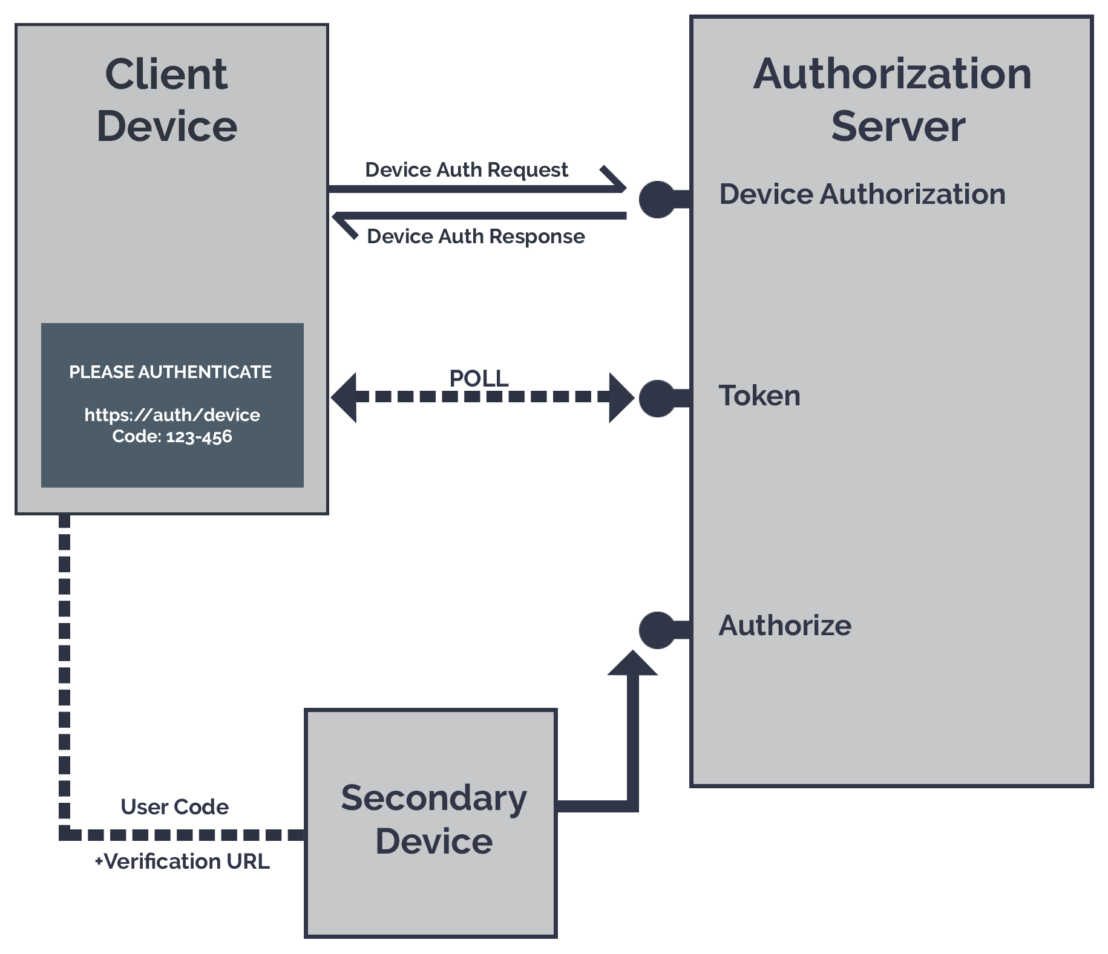
Device Pillar
2.3 Device Authorization with Real time Inspection
2.3.1 Entity Activity Monitoring Pt1 (Advanced)
2.3.2 Entity Activity Monitoring Pt2 (Advanced)
2.3.3 Implement Application Control & File Integrity Monitoring (FIM) Tools (Target)
2.3.4 Integrate NextGen AV Tools with C2C (Target)
2.3.5 Fully Integrate Device Security stack with C2C as appropriate (Advanced)
2.3.6 Enterprise PKI Pt1 (Advanced)
2.3.7 Enterprise PKI Pt2 (Advanced)
Notes:
The third capability is device authorization with real time inspection and it has seven associated activities.
Entity Activity Monitoring Pt1 has the following requirements: User Entity and Behavior Analytics (UEBA) attributes are integrated for device baselining; UEBA attributes are available for usage with device access.
Some examples of UEBA attributes are geographic location, work schedule, application use, Website use, and others.
Entity Activity Monitoring Pt2 has the following requirements: UEBA attributes are mandated for device access.
Implement Application Control & File Integrity Monitoring (FIM) Tools has the following requirements: AppControl and FIM tooling is implemented on all critical services/applications; Endpoint Detection and Response (EDR) tooling covers maximum amount of services/applications; AppControl and FIM data is sent to C2C as needed.
Integrate NextGen AV Tools with C2C has the following requirements: Critical NextGen Antivirus data is being sent to C2C for checks ; NextGen AV tooling is implemented on all critical services/applications.
Fully Integrate Device Security stack with C2C as appropriate has the following requirements: AppControl and FIM deployment is expanded to all necessary services/applications; Remaining data from Device Security tooling is implemented with C2C.
Enterprise PKI Pt1 has the following requirements: Devices that are unable to have certificates are phased out and/or moved to minimal access environments; All devices and NPEs have certs installed for authentication in the Enterprise PKI.
Enterprise PKI Pt2 has the following requirements: Devices are required to authenticate to communicate with other services and devices.

Slide 8
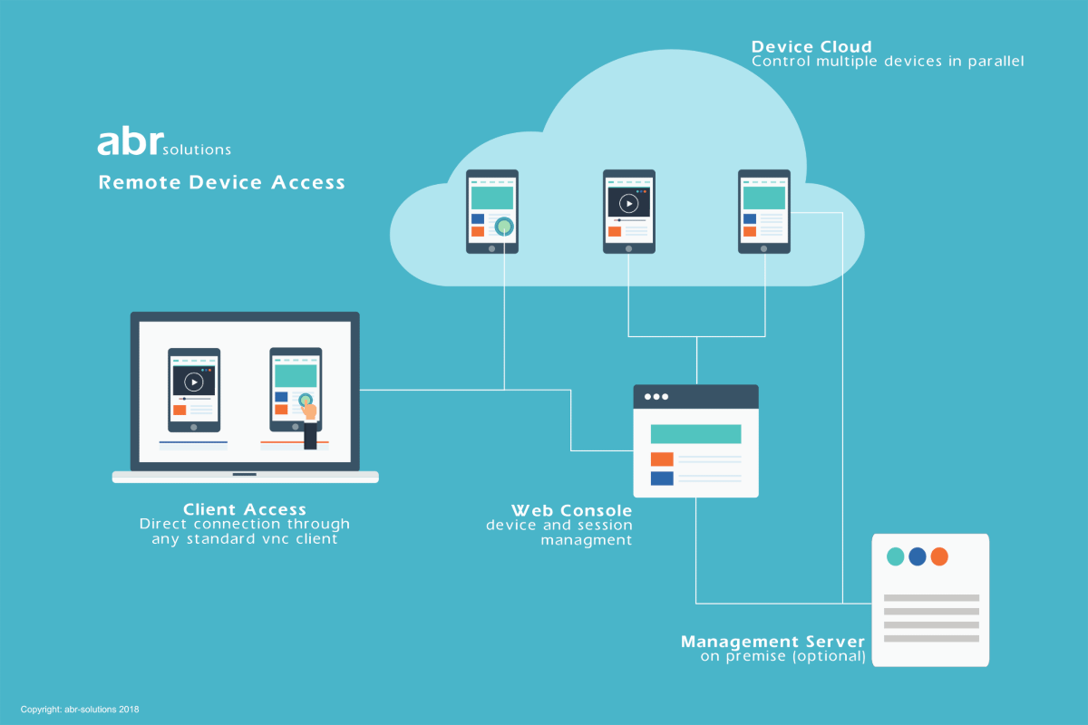
Device Pillar
2.4 Remote Access
2.4.1 Deny Device by Default Policy (Target)
2.4.2 Managed and Limited BYOD & IOT Support (Target)
2.4.3 Managed and Full BYOD & IOT Support Pt1 (Advanced)
2.4.4 Managed and Full BYOD & IOT Support Pt2 (Advanced)
Notes:
The fourth capability in the device pillar is remote access and it has four associated activities.
Deny Device by Default Policy has the following requirements: Components can block device access by default to resources (apps/data) and explicitly allow compliant devices per policy; Remote Access is enabled following a "deny device by default policy" approach.
Managed and Limited BYOD & IOT Support has the following requirements: All applications require dynamic permissions access for devices; BYOD and IOT device permissions are baselined and integrated with Enterprise IDP.
Managed and Full BYOD & IOT Support Pt1 has the following requirements: Only BYOD and IOT devices that meet mandated configuration standards allowed to access resources; Critical Services require dynamic access for devices.
Managed and Full BYOD & IOT Support Pt2 has the following requirements: All possible services require dynamic access for devices.

Slide 9
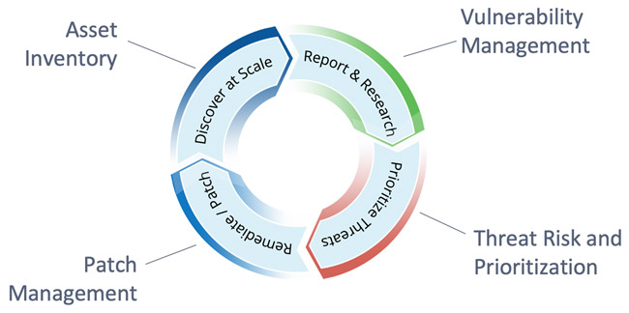
Device Pillar
2.5 Partially & Fully Automated Asset, Vulnerability and Patch Management
2.5.1 Implement Asset, Vulnerability and Patch Management Tools (Target)
Notes:
The fifth capability of the device pillar is partially & fully automated asset, vulnerability and patch management and has one associated activity.
Implement Asset, Vulnerability and Patch Management tools has the following requirements: Components can confirm if devices meet minimum compliance standards or not; Components have asset management, vulnerability, and patching systems with APIs that will enable integration across the systems.

Slide 10
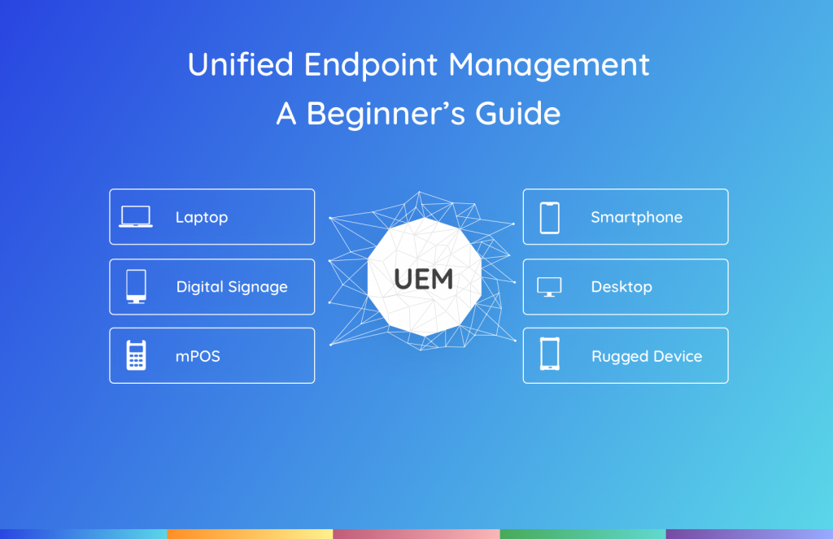
Device Pillar
2.6 Unified Endpoint Management (UEM) & Mobile Device Management (MDM)
2.6.1 Implement UEDM or equivalent Tools (Target)
2.6.2 Enterprise Device Management Pt1 (Target)
2.6.3 Enterprise Device Management Pt2 (Target)
Notes:
The sixth capability in the device pillar is unified endpoint management (UEM) & mobile device management and it has three associated activities.
Implement UEM or equivalent tools has the following requirements: Components can confirm if devices meet minimum compliance standards or not; Components have asset management system(s) for user devices (phones, desktops, laptops) that maintains IT compliance, which is reported up to DoD enterprise; Components asset management systems can programmatically, ie, API, provide device compliance status and if it meets minimum standards.
Enterprise Device Management Pt1 has the following requirements: Manual inventory is integrated with an automated management solution for critical services; Enable ZT Device Management (from any location with or without remote access).
Enterprise Device Management Pt2 has the following requirements: Manual inventory is integrated with an automated management solution for all services.

Slide 11
Device Pillar
2.7 Endpoint & Extended Detection & Response (EDR & XDR)
2.7.1 Implement Endpoint Detection & Response (EDR) Tools and Integrate with C2C (Target)
2.7.2 Implement Extended Detection & Response (XDR) Tools and Integrate with C2C Pt1 (Target)
2.7.3 Implement Extended Detection & Response (XDR) Tools and Integrate with C2C Pt2 (Advanced)
Notes:
The seventh and final capability within the devices pillar is endpoint & extended detection & response and it has three associated activities.
Implement Endpoint Detection & Response (EDR) Tools and Integrate with C2C has the following requirements: Endpoint Detection & Response Tooling is implemented ; Critical EDR data is being sent to C2C for checks; NextGen AV tooling covers maximum amount of services/applications.
Implement Extended Detection & Response (XDR) Tools and Integrate with C2C Pt1 has the following requirements: Integration Points have been identified per Capability; Riskiest integration points have been integrated w/ XDR; Basic alerting is in place with SIEM and/or other mechanisms.
Implement Extended Detection & Response (XDR) Tools and Integrate with C2C Pt2 has the following requirements: Remaining integration points have been integrate as appropriate; Extended alerting and response is enabled with other Analytics tools at least using SIEM.

Slide 12
Conclusion
Devices Pillar
Key Components:
Device Inventory
Comply To Connect
Device Authorization
Endpoint Security
Notes:
The devices pillar of Zero Trust is extremely important in the overall implementation of ZT. We have covered which target and advanced activities that we are required to implement by 2027. Many of these are relevant to tactical environments where you will be directly implementing them, while others may be important for you to know about because they are being implemented at other levels and will require you to change how you operate in order to effectively be interoperable.
For the Devices pillar, implementing a methodology and maintaining a device inventory, implementing comply to connect in your environment, utilizing device authorization in addition to device authentication and finally implementing an EDR/XDR solution will significantly push you towards a ZT environment. Interoperability, and integration between the devices pillar tools and other ZT tools will dictate how far you can successfully implement ZT. If your devices pillar does not work with other pillars, then you are implementing security in the legacy defense in depth method.

Slide 13
Questions
CW3 Ben Koontz; benjamin.r.koontz2.mil@army.mil
Notes:
Please feel free to e-mail me or contact me on Office 365 Teams for any questions on the presentation or Zero Trust in general.

