Slide 1
Pillar 1 Users
CW4 Ben Koontz
Notes:
Hello, my name is CW3 Ben Koontz and I will be covering the topic, Zero Trust, Pillar 1 Users.

Slide 2
Course Objectives
The student will be able to understand the Users Pillar of Zero Trust
The student will understand the 9 capabilities and 28 activities outlined in the Users Pillar
The student will understand the difference between target and advanced activities
Notes:
The course objectives are as follows:
The student will be able to understand the Users Pillar of Zero Trust
The student will understand the 9 capabilities and 28 activities outlined in the Users Pillar
The student will understand the difference between target and advanced activities

Slide 3
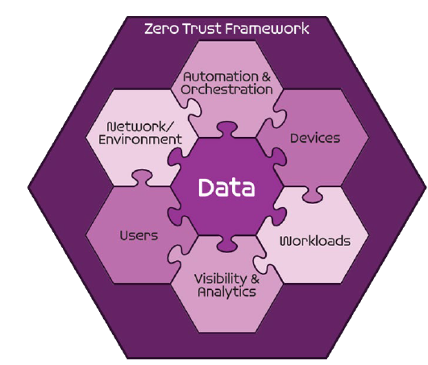
Seven Pillars of Zero Trust
User
Device
Applications and Workload
Data
Network and Environment
Automation and Orchestration
Visibility and Analytics
DoD ZT Reference Architecture v 2.0
Notes:
The Zero Trust seven pillars are protection pillars that work together to effectively secure the data pillar. These pillars are in alignment with industry but may have different names.
The first pillar is the user pillar, which secures, limits and enforces person and non-person entities access to data, applications, assets and services.

Slide 4
Sample Zero Trust Access Flow
Vulnerability Mgmt
Resource Authorization
DevSecops
1
EDR./XDR
Comply to connect
Device inventory
Devices
Application & Workload
authenticate
Services
request
Policy Enforcement Point
4
3
[user, device]
authenticate
Micro Segmentation
Macro Segmentation
SOAR
Machine Learning
Artificial intelligence
Policy Orchestration
data
Orchestration & Automation
DLP
DRM
DATA ACLs
Data Tags and Labels
2
Users
Network & Environment
MFA
PAM
ICAM
User ACLs
User Attributes
Logs
Logs
Logs
Logs
Logs
5
SIEM
Behavior analytics
Threat analytics
Threat intelligence
Visibility & Analytics
Device Authenticates
User Authenticates
Access Decision at PEP
Access to Data and Services
Security Analytics Decision
Notes:
You will see this Zero Trust Access flow slide in each pillar to use to identify where each pillar fits in a full ZT architecture.
The Users Pillar is responsible for ensuring the identity is protected and that it is given access only to what is needed. Multifactor authentication, privileged access management, Identity and Credential Access Management, User Access Control Lists and User Attributes are capabilities that allow you to achieve Zero Trust in the Users Pillar. We will cover more of this in later slides.
When a user authenticates to the environment, the users pillar capabilities will be assessed before they are able to access resources or data.

Slide 5
User Pillar
Capabilities (45) versus Activities (152)
Target Versus Advanced Activities:
91 Target Activities
61 Advanced Activities
Target due NLT end of FY 2027

Slide 6
User Pillar
1.1 User Inventory (Capability)
1.1.1 Inventory User (Target)
Notes:
The first capability outlined in the User Pillar is User Inventory with the Inventory User activity.
You will see the difference between target and advanced throughout the courses. Target means that these activities are required to be implemented by 2027. Advanced activities will begin to be required after that date. You can implement advanced activities now, but they are not required per the DoD. Whatever you can do to improve your security is ideal.
The desired outcomes for Inventory User from the DoD Activities guide are as follows: The organization has Identified Managed Regular Users; Identified Managed Privileged Users; Identified applications using their own user account management for non-administrative and administrative accounts.
There may be numerous ways to achieve these outcomes. The Army utilizes the Army Training Certification Tracking System (ATCTS) to track the compliance of users as well as inventory users. Using a methodology to compare ATCTS with the current user inventory will get you on track to meet this requirement.

Slide 7
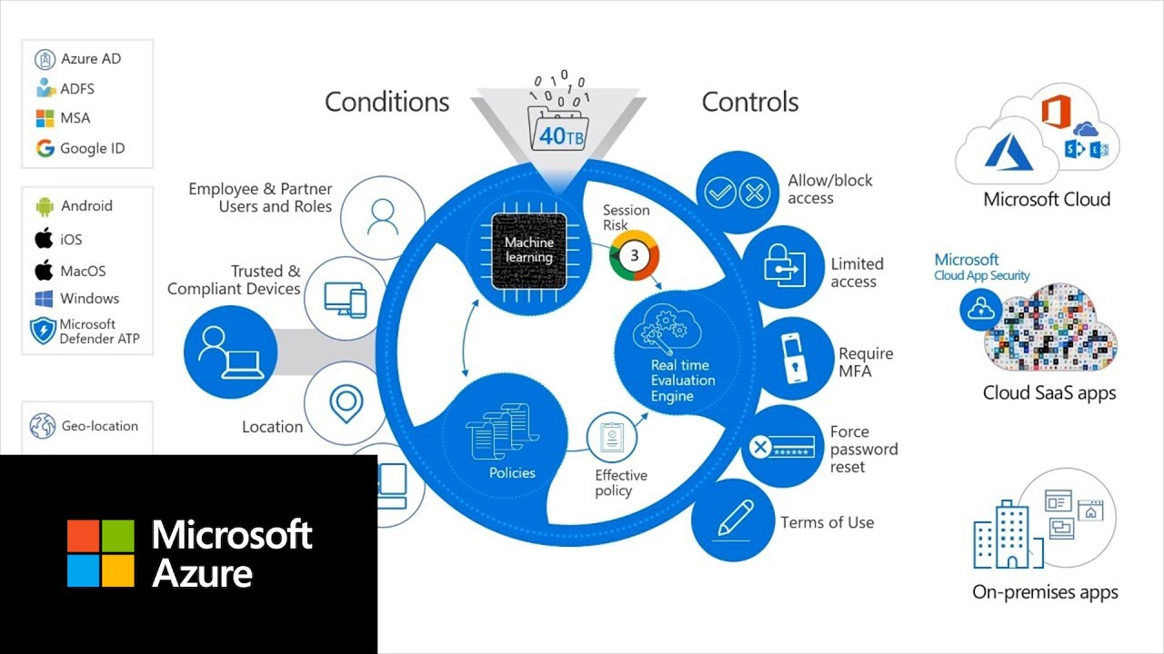
User Pillar
1.2 Conditional User Access
1.2.1 Implement App Based Permissions per Enterprise (Target)
1.2.2 Rule Based Dynamic Access Pt1 (Target)
1.2.3 Rule Based Dynamic Access Pt2 (Advanced)
1.2.4 Enterprise Gov't roles and Permissions Pt1 (Advanced)
1.2.5 Enterprise Gov't roles and Permissions Pt2 (Advanced)
Notes:
The second capability within the User pillar is Conditional User Access and it contains five activities underneath it.
Implement App Based Permissions Per Enterprise has the following requirements: Enterprise roles/attributes needed for user authorization to application functions and/or data have been registered with enterprise ICAM; DoD Enterprise ICAM has self-service attribute/role registration service that enables application owners to add attributes or use existing enterprise attributes; Privileged activities are fully migrated to PAM.
To break this activity down further, it requires an Enterprise ICAM solution to be developed to ensure the appropriate roles and attributes are created for all accounts. A standardized roles/attributes schema allows interoperability for all organizations within the Enterprise.
Rule Based Dynamic Access Pt1 has the following requirements: Access to application’s/service’s functions and/or data are limited to users with appropriate enterprise attributes; All possible applications use Just in Time(JIT)/Just Enough Access(JEA) permissions for administrative users.
This activity means that the enterprise is using JIT/JEA for administrative users and are using proper access controls for regular user accounts. Setting up JIT access can be a challenge in the military due to needing administrators to have permissions at all times when called in for emergencies, so this is a tricky implementation to setup to ensure you are meeting operational requirements as well as security requirements. JEA is just the act of implementing the principal of least privilege for administrator accounts and most of this is covered by STIGs currently in place.
Rule Based Dynamic Access Pt2 has the following requirements: Components and services are fully utilizing rules to enable dynamic access to applications and services; Technology utilized for Rule Based Dynamic Access supports integration with AI/ML tooling.
This activity adds on to the last activity with the requirement that Artificial Intelligence (AI) and Machine Learning (ML) are integrated into the access control decision.
Enterprise Gov’t roles and Permissions Pt1 has the following requirements: Component attribute and role data repository federated with enterprise ICAM; Cloud-based enterprise Identity Provider (IdP) can be used by cloud and on-premises applications; A standardized set of roles and permissions are created and aligned to attributes.
This activity requires that your user roles repository is federated with enterprise ICAM, so that you have interoperability between other DoD entities.
Enterprise Gov’t roles and Permissions Pt2 has the following requirements: Majority of components utilize cloud IdP functionality Where possible on-prem IdP is decommissioned; Permissions and roles are mandated for usage when evaluating attributes.
The major change in this activity is that it requires the majority of components to utilize a cloud based IdP versus on-prem IdP solutions.

Slide 8
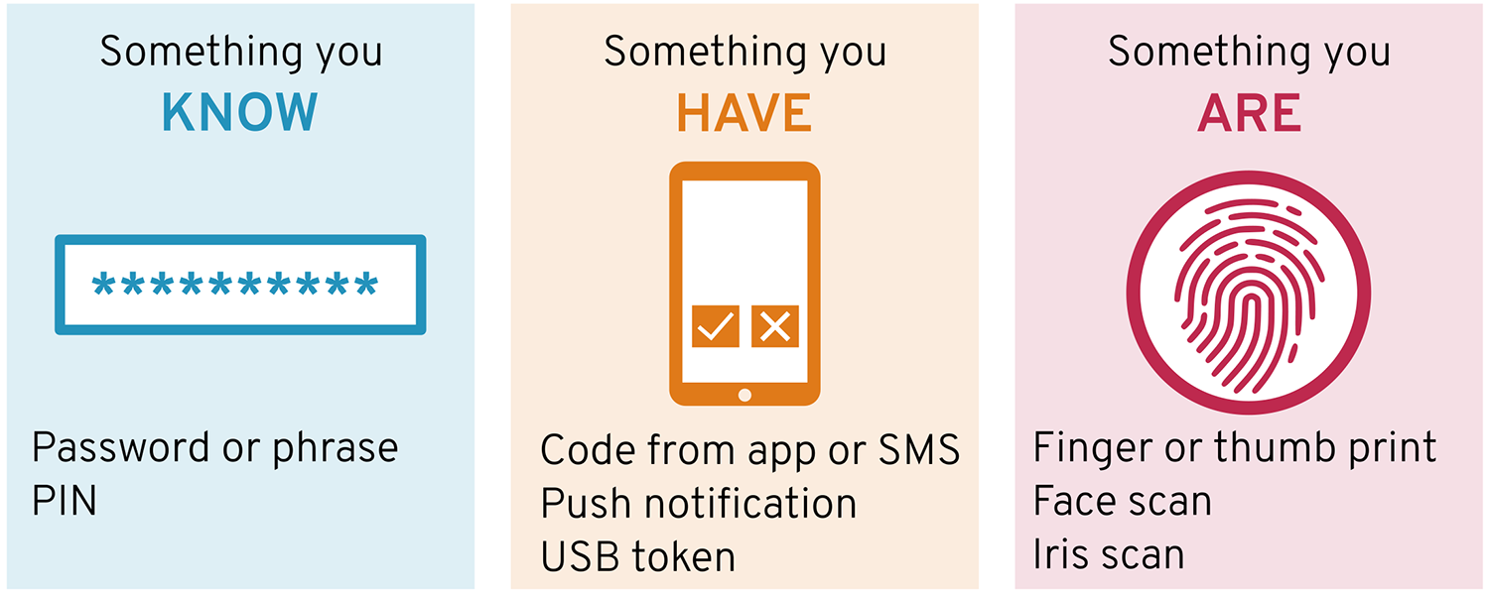
User Pillar
1.3 Multi-Factor Authentication (MFA)
1.3.1 Organizational MFA/IDP (Target)
1.3.2 Alternative Flexible MFA Pt1 (Advanced)
1.3.3 Alternative Flexible MFA Pt2 (Advanced)
Notes:
The third capability within the User Pillar is Multi-Factor Authentication and it has three activities associated with it.
Organizational MFA/IDP has the following requirements: Component is using IdP with MFA for critical applications/services; Components have implemented an Identity Provider (IdP) that enables DoD PKI multifactor authentication; Organizational Standardized PKI for critical services.
Alternative Flexible MFA Pt1 has the following requirements: IdP provides user self-service alternative token; IdP provides alt token MFA for approved applications per policy.
Alternative Flexible MFA Pt2 has the following requirements: User Activity Patterns Implemented.
User activity patterns looks at criteria, such as geographic location, time of access, and even typing speed and application use and other criteria.

Slide 9
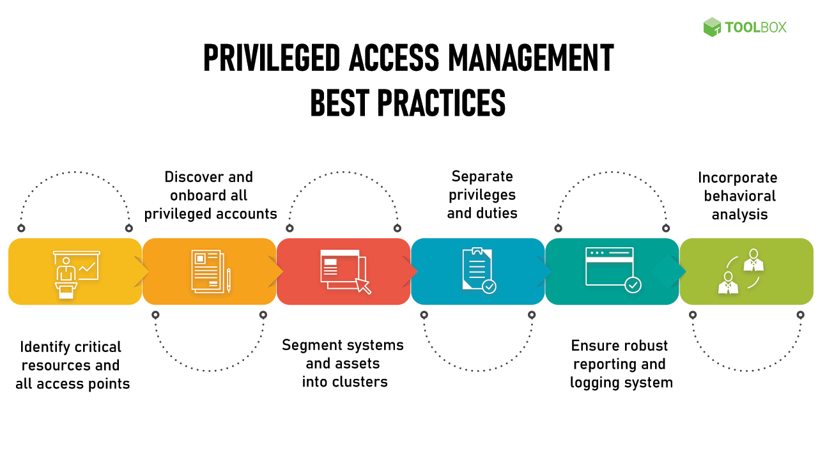
User Pillar
1.4 Privileged Access Management (PAM)
1.4.1 Implement System and Migrate Privileged Users Pt1 (Target)
1.4.2 Implement System and Migrate Privileged Users Pt2 (Target)
1.4.3 Real time Approvals & JIT/JEA Analytics Pt1 (Advanced)
1.4.4 Real time Approvals & JIT/JEA Analytics Pt2 (Advanced)
Notes:
The fourth capability within the User pillar is Privileged Access Management which has four activities associated with it.
Implement System and Migrate Privileged Users Pt1 has the following requirements: Privilege Access Management (PAM) tooling is implemented; Identified applications that support and do not support PAM tools; Applications that support PAM, now use PAM for controlling emergency/built-in accounts.
Implement System and Migrate Privileged Users Pt2 has the following requirements: Privileged activities are migrated to PAM and access is fully managed.
Real time Approvals & JIT/JEA Analytics Pt1 has the following requirements: Identified accounts, applications, and data of concern (of greatest risk to DoD mission); Using PAM tools, applied JIT/JEA access to high-risk accounts; Privileged access requests are automated as appropriate.
Real time Approvals & JIT/JEA Analytics Pt2 has the following requirements: User Entity and Behavior Analytics (UEBA) or similar analytic system integrated with PAM tools for JIT/JEA account approvals.
These activities are getting after ensuring all privileged accounts are part of a privileged access management suite and that access approvals are applied using JIT/JEA and are integrated with UEBA for maximum security capabilities.

Slide 10
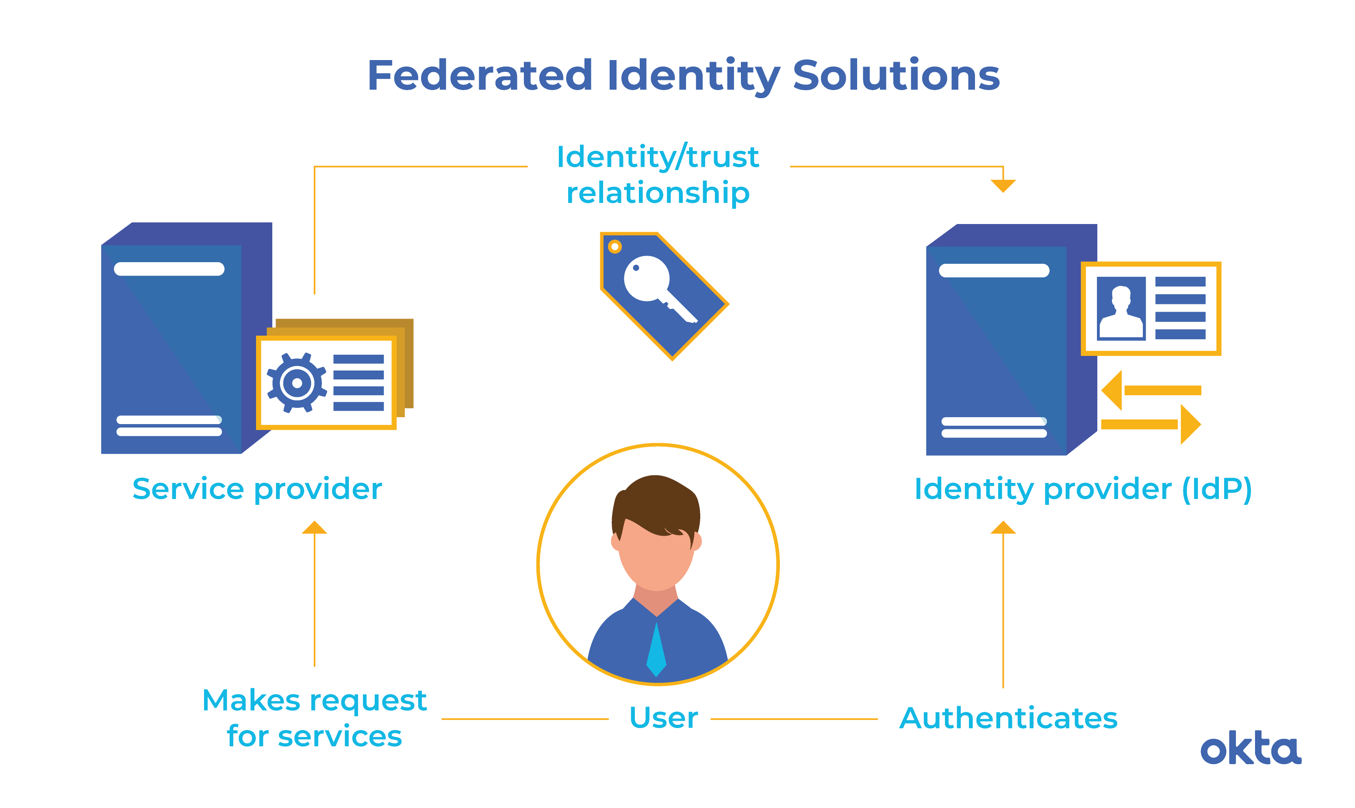
User Pillar
1.5 Identity Federation & User Credentialing
1.5.1 Organizational Identity Life-Cycle Management (Target)
1.5.2 Enterprise Identity Life-Cycle Management Pt1 (Target)
1.5.3 Enterprise Identity Life-Cycle Management Pt2 (Advanced)
1.5.4 Enterprise Identity Life-Cycle Management Pt3 (Advanced)
Notes:
The fifth capability within the User Pillar is Identity Federation & User Credentialing and it is associated with four activities.
Organizational Identity Life-Cycle has the following requirements: Standardized Identity Lifecycle Process.
Enterprise Identity Life-Cycle Management Pt1 has the following requirements: Automated Identity Lifecycle Processes; Integrated with Enterprise ICAM process and tools .
Enterprise Identity Life-Cycle Management Pt2 has the following requirements: Integration w/ Critical IDM/IDP functions; Primary ILM functions are cloud based.
Enterprise Identity Life-Cycle Management Pt3 has the following requirements: All ILM functions moved to cloud as appropriate; Integration with all IDM/IDP functions.
Identity life cycle management is the process of managing the user credentialing process to ensure updated permissions are applied as each user requires different access based on their duties as they move between position. It also looks at the evolution of technological improvements and is used as a maintenance and a checks and balances for the identity solution.

Slide 11
User Pillar
1.6 Behavioral, Contextual ID, and Biometrics
1.6.1 Implement User & Entity Behavior Activity (UEBA) Tooling (Target)
1.6.2 User Activity Monitoring Pt1 (Advanced)
1.6.3 User Activity Monitoring Pt2 (Advanced)
Notes:
The sixth capability within the User Pillar is Behavioral, Contextual ID, and Biometrics with three associated activities.
Implement User & Entity Behavior Activity (UEBA) Tooling has the following requirements: UEBA functionality is implemented for Enterprise IDP.
User Activity Monitoring Pt1 has the following requirements: UEBA is integrated with Org IDPs as appropriate; UEBA is integrated with JIT/JEA for critical services.
User Activity Monitoring Pt2 has the following requirements: UEBA/Entity Monitoring is integrated with JIT/JEA for all services.
Behavioral analytics is integrated in several of the other activities that we have seen so far. The bottom line is that it is important to implement additional dynamic and behavioral analytics into your Zero Trust solution in order to automate the detection of malicious activity and to increase the magnitude of difficulty for an adversary to have success. Mimicing mouse activity, keystroke movement and other factors would be incredibly difficult especially when adversaries are utilizing adversary techniques.

Slide 12
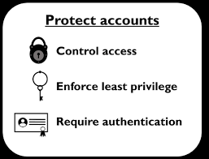
User Pillar
1.7 Least Privileged Access
1.7.1 Deny User by Default Policy (Target)
Notes:
The seventh capability is Least Privilege Access and is associated with one activity.
Deny User by Default policy as the following requirements: Applications updated to deny by default to functions/data requiring specific roles/attributes for access; Reduced default permissions levels are implemented; Applications/services have reviewed/audited all privileged users and removed those users who do not need that level of access; Applications' identify functions and data requiring specific roles/attributes for access.

Slide 13
User Pillar
1.8 Continuous Authentication
1.8.1 Single Authentication (Target)
1.8.2 Periodic Authentication (Target)
1.8.3 Continuous Authentication Pt1 (Advanced)
1.8.4 Continuous Authentication Pt2 (Advanced)
Notes:
The eighth capability in the User Pillar is Continuous Authentication and it has four associated activities.
Single Authentication has the following requirements: Authentication implemented across applications per session.
Single authentication means that once you have authenticated once, then you are good to access all resources with the security token you have been provided based on your permissions of your login.
Periodic Authentication has the following requirements: Authentication implemented multiple times per session based on security attributes.
Periodic authentication requires a user to re-authenticate multiple times per session. Where I see this happening is if you are logging in an application and doing regular user work, you won’t get prompted for additional authentication, but if you are trying to do something critical such as change a password or make modifications, it will prompt you to re-authenticate to validate that you truly want to do this action. This makes it much more difficult for adversaries.
Continuous Authentication Pt1 has the following requirements: Transaction authentication implemented per session based on security attributes.
Continuous Authentication Pt2 has the following requirements: Transaction authentication implemented per session based on security attributes.
Part 1 and Part 2 are identical, so my first guess would be that part two adds additional re-authentication techniques, but as you will see from the slides, some of these activities need further clarity from the DoD.

Slide 14
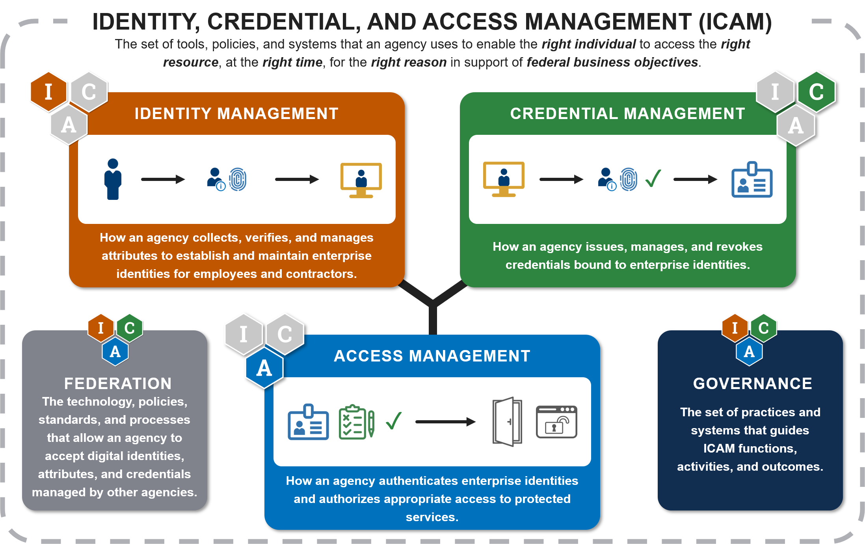
User Pillar
1.9 Integrated ICAM Platform
1.9.1 Enterprise PKI/IDP Pt1 (Target)
1.9.2 Enterprise PKI/IDP Pt2 (Advanced)
1.9.3.Enterprise PKI/IDP Pt3 (Advanced)
Notes:
The ninth and final capability within the User Pillar is the Integrated ICAM Platform and it has three associated activities.
Enterprise PKI/IDP Pt1 has the following requirements: Components are using IdP with MFA for all applications/services; Organizational MFA/PKI integrated with Enterprise MFA/PKI; Organizational Standardized PKI for all services.
Enterprise PKI/IDP Pt2 has the following requirements: Critical Organizational Services Integrated w/ Biometrics; Decommission organizational MFA/PKI as appropriate in lieu of enterprise MFA/PKI; Enterprise Biometric Functions Implemented.
Enterprise PKI/IDP Pt3 has the following requirements: All Organizational Services Integrate w/ Biometrics.

Slide 15
Conclusion
Users Pillar
Key Components:
Multi-factor Authentication
ICAM
Access Control
Privileged Access Management
Behavior Based Analytics
Granular User Attributes for Access Control
Notes:
The users pillar of Zero Trust is extremely important in the overall implementation of ZT. We have covered which target and advanced activities that we are required to implement by 2027. Many of these are relevant to tactical environments where you will be directly implementing them, while others may be important for you to know about because they are being implemented at other levels and will require you to change how you operate in order to effectively be interoperable. Have a solid ICAM solution with access control configured in the principal of least privilege and utilizing MFA and behavior analytics where you can will go a long way in significantly improving your Cyber defense posture as well as in implementing Zero Trust.

Slide 16
Questions
CW4 Ben Koontz; benjamin.r.koontz2.mil@army.mil
Notes:
Please feel free to e-mail me or contact me on Office 365 Teams for any questions on the presentation or for Zero Trust in general.

